Slide 1
Board of Equalization Training
2025 – New Members & Clerks
Presented by Rikki Bland et all
June 3-4, 2025

Slide 2
Agenda & Welcome
Board of Equalization New Member Training - 2025

Slide 3
Introductions
Presenters:
Rikki Bland, Manager CP&A
Diana Burch, County Review Auditor
Melissa Olivas, CP&A Supervisor
Marilyn O’Connell, Revaluation Specialist
Janeene Niemi, Current Use & Education Specialist
Laura Osborne, Individual Benefits Specialist
Andrew Krawczyk, AAG
Callie Barrett, AAG

Slide 4
Legislative Update
Exemptions
Current Use
Green Energy
EHB 1106 : Phasing down the disability rating requirements to ensure more disabled veterans are eligible for property tax relief.
From 80% to 40%
ESB 5529: Allows additional counties and cities to authorize a property tax exemption for the construction of accessory dwelling units rented to low-income households.
Counties with a population of over 900,000 and cities within those counties may allow the exemption.
SHB 1261Allows U-Pick between 5 and 20 acres to count income from U-Pick sales toward income requirements for current use classification.
“Appurtenance” includes portable sanitation equipment.
“Incidental use” includes unpaved parking for visitors, limited to 20% of the land.
Prevents removal due to minor upgrades or limited compatible uses (e.g., education, festivals, weddings), unless they exceed the 20% incidental use limit or the structure no longer qualifies.
Reduces the additional tax period from 7 to 4 years for land removed or withdrawn on or after Sept. 1, 2025.
Clarifies alignment in statutes related to the 20% penalty.
ESSB 5445: Allows for an “agrivoltaic facility” to be located on classified farm and agricultural land, under the Open Space Taxation Act, when designed and operated coincident with the continued agricultural use of the land.
Specifies that the addition of an agrivoltaic facility is not grounds for removal or withdrawal from the program.

Slide 5
Assessed, Levied, & Collected.
Property Tax 101
Overview of Washington’s property tax system
Vocabulary
Why it Matters?
Key Concepts.
Taxability, Uniformity, Valuation Dates.
Roles and Responsibilities
Who does what?
When Does it Happen?
Watch our Understanding Property Tax video

Slide 6
Essentials for understanding appeals
Arm’s Length Transaction: A sale made freely without pressure or special reasons, where the buyer and seller act independently without any personal or financial ties influencing the deal.
Assessment Year: The calendar year during which a property’s value is determined.
Fair Market Value (FMV): The price a property would likely sell for in an open, competitive market, representing its true worth.
Market: A group of properties for sale in a specific area that share similar features.
May: Indicates something is optional or allowed, but not required.
Shall: Indicates a legal requirement; something that must be done.
Petitioner: A property owner who requests a review or appeal of their property’s assessed value. Also called an “appellant.”
Basic Vocabulary
Notes:
Arm’s Length Transaction —a sale made freely, without pressure, special motives, or personal or economic ties between the buyer and seller. What this means in plain language is that the sale is most likely at fair market value — the seller is trying to get the best price, and the buyer isn’t going to pay too much.
Assessment Year —the calendar year when the property is valued for the next year’s taxes. For example, right now we’re in the 2025 assessment year. By May 31st, assessors ideally have done their inspections and plugged all the sales data into their systems, sent out change of value notices, and then appeals start coming in July 1st. The timing is important because counties need to know their budgets by fall to figure out how much money they’ll collect in 2026, for taxes based on 2025 values.
Fair Market Value (FMV). —the price a property would sell for in an open, competitive market. Marc, our revaluation auditor, will dive deep into valuation, so I won’t steal his thunder — but before we can talk about FMV, you need to understand what a market actually is.
Market —properties in a certain area that have similar features and price points. But it’s more nuanced than just a location. For example, in Seattle, a condo overlooking I-5 isn’t in the same market as one overlooking Lake Washington — that view alone sets them apart. So you can’t just say, “Seattle homes average this price, so mine should be that too.” Seattle is huge! Think of it like MMA weight classes — I weigh 180 pounds preparing for a tournament, and I’m not going to have a fair fight against a 240-pound opponent. Houses compete only within their own “weight class,” or market.
May — not the month! When we’re reading laws and rules, “may” means optional. It means you can do something, but you don’t have to. Don’t confuse it with “must.”
Must — this means you have to do it. It’s a legal requirement. You’ll also see “shall” used in laws — it sounds softer, but it means the same thing: you’re legally obligated to do it. For example, when WAC 458-14-156 says “Board members and clerks shall attend board of equalization training seminars,” that means you must attend those trainings. No wiggle room!
Petitioner — simply put, this is the taxpayer who files a petition with the Board of Equalization. You’ll hear “petitioner,” “taxpayer,” and “appellant” used interchangeably — they all mean the same person.

Slide 7
Why Property Tax Matters
What is Property Tax?
What does it do?
Why appeals?
Property tax was the first tax levied in Washington.
Accounts for about 30% of total state and local taxes.
Ad Valorem: Based on the value.
Funds essential services like public schools, fire protection, libraries, and parks.
Provides stable, predictable revenue for counties, cities, and taxing districts.
Provides accountability for assessors’ decisions.
Builds public trust in the property tax system.

Slide 8
Key Concepts
Tax
Administered locally
All property is taxable, unless specifically exempted by law under RCW 84.40.020.
Assessed value is determined prior to tax calculations.
Uniformity
All property is to be assessed at 100% of its true and fair market value.
Tax rates must be uniform within each taxing district.
Rates apply equally to all property types.
Proportionate Burden
The tax is based on the value of the property (ad valorem).
Higher-value properties pay proportionally more in taxes.
Notes:
Property Tax is an Ad Valorem Tax
The values are determined using appropriate tools, practices, and methodology to review and determine assessed values.
Types of Taxable Property:
Most commonly real property (land and buildings).
Also applies to personal property, unless specifically exempt.
Exemptions:
Some properties are exempt by statute (RCW 84.36.005).
Example: Senior exemptions, where property values may be frozen.
Uniformity & Equity in Taxation:
The WA Constitution (article VII) requires property tax to be uniform, including joint taxing districts and personal property.
Proportional Tax Burden Example:
$200,000 property pays twice the tax of a $100,000 property.
$1,000,000 property pays ten times the tax of a $100,000 property.

Slide 9
Key Concepts
Assessment Dates
All real property must be listed and assessed as of January 1st each year.
Increases in value due to new construction or permitted alterations are added to the rolls by August 31st.
Property Types
Real: Includes the land itself, buildings, and structures or improvements.
Personal: Property used for the purpose of doing business and is not affixed to land
Valuation Notice & Other Determinations
Must be sent when a property's total assessed value changes from the prior year
Must be sent when an appealable decision is made.
Notes:
Annual Assessment Date (RCW 84.40.020):
All real property must be assessed as of January 1st each year.
New Construction (RCW 36.21.080):
New improvements (e.g., buildings, additions) are added to the assessment roll up to August 31st.
These improvements are valued as of July 31st.
Why Assessment Dates Matter
When reviewing appeals, it's crucial to understand assessment dates.
Petitioners often provide sales data as evidence.
Always check if the sales occurred on or before January 1st.
Sales after the assessment date may not reflect the property’s value as of January 1st.
Timing matters: sales must align with the date the property was legally valued.
Appealing Property Tax
Taxpayers often want to challenge the amount of their tax bill, but:
State law does not allow appeals on tax amounts.
Appeals must focus on the assessed value of the property.
Real Property
A parcel's assessed value is made up of two components:
Land value
Improvements/buildings value
Personal Property
Includes machinery, equipment, and trade fixtures (e.g., desks, chairs) that are not permanently attached to real estate.
Personal property is assessed and taxed at the same rate as real property.
For classification questions (real vs. personal), refer petitioners to the assessor’s office.
Taxpayers must appeal the total assessed value, not just a portion.
A petition disputing only the building or land is acceptable as evidence, but the entire parcel value must be under appeal.
Change of Value Notice (RCW 84.40.045)
No notice is required if the total assessed value remains the same.

Slide 10
What is it & why is it important?
Key Elements:
Notice: Of the hearing.
Right to Know Claims: Each party should be aware of what has been submitted to the board.
Opportunity to Be Heard: To appear and present evidence.
Reasonable Time: To prepare one’s case.
Orderly Proceeding: A structured process.
Right to Cross-Examine: And present rebuttal evidence.
Impartial Tribunal: The board must remain unbiased.
Reasoned Decision: The decision must be based on facts and law.
Due Process
Notes:
Importance in Property Tax Appeals:
Fairness for All Parties: Due process ensures both taxpayers and the assessor’s office are treated fairly during the appeal process.
Opportunity for Taxpayers: Taxpayers can contest property assessments in a transparent and impartial environment.
Opportunity for Assessors: The assessor's office has the chance to present their findings and defend their assessments.
Key Elements of Due Process:
Notice of hearings
The right to present evidence
The right to a reasoned decision
Ensures Trust and Integrity: Adhering to due process promotes trust in the system and ensures decisions are based on facts and law.

Slide 11
Assessor
Local Valuation and Exemption Decisions
Determines the value of all taxable real and personal property.
Applies exemptions and tracks property tax relief programs.
Maintains property records (ownership, boundaries, use, etc.).
Sets levy rates used to calculate property taxes.
Sends valuation notices to property owners.
Notes:
Market Value (also called "true and fair value") is the price a willing buyer would pay a willing seller when neither is under pressure.
All property in Washington must be valued at 100% of market value unless a specific law allows otherwise.
WAC 458-14-005 defines market value as the fair amount considering the property’s potential uses.
Assessed Value is the value placed on a property for tax purposes, determined by the county assessor.
Assessed value is usually based on market value, but may be reduced if the property qualifies for exemptions such as:
Senior or disabled person exemption
Current use program
Historic property designation

Slide 12
Treasurer
Billing, Collection, & Distribution
Collects property taxes from all taxable properties in the county.
Distributes revenue to local taxing districts (schools, fire, cities, etc.).
Manages payment options, including due dates, partial payments, and delinquencies.
Handles foreclosures for unpaid property taxes.
Invests county funds and manages short-term cash flow.
Notes:
The County Treasurer plays a key role in the property tax system. Once the assessor has set values and the Board of Equalization has handled any appeals, the treasurer is responsible for billing, collecting, and distributing property taxes.
Taxes are due in two halves: April 30 and October 31.
The treasurer’s office accepts payments, processes delinquencies, and can set up payment plans for struggling taxpayers.
If taxes go unpaid for three years, the treasurer initiates foreclosure.
In addition to property tax duties, the treasurer also invests county funds, ensuring cash is available for local governments to operate throughout the year.

Slide 13
Board of Equalization
Local Review of Property Tax Appeals
Purpose: To ensure property assessments are fair, accurate, and consistent across the county.
Composition: Typically, three appointed members, such as realtors or appraisers, attorneys, and local citizens.
Role: To resolve disputes between property owners and the assessor's office, primarily related to property valuation.
*Also hears disputes regarding other decisions made by the assessor’s office unrelated to valuation.
Equalization: Occurs without an appeal, where the BOE compares assessments to ensure comparable properties are valued similarly.
Notes:
Administrative appeals provide an inexpensive and simplified process for taxpayers.
These are quasi-judicial proceedings where boards offer an impartial hearing environment to ensure due process and fair decisions for both parties.
The Board's jurisdiction includes appeals related to Assessor determinations, such as:
Changes in real and personal property values (RCW 84.48.010)
Denials of senior citizen or disabled person exemptions (RCW 84.36.385)
Denials of home improvement exemptions (RCW 84.36.400)
Decisions regarding historic property (RCW 84.26.130)
Forest land classification determinations (RCW 84.33)
Current use determinations (RCW 84.34)
Destroyed property determinations of percentage of reduction (RCW 84.70.010)
Claims for real or personal property tax exemptions (RCW 84.36.010)
Must be directly appealed to Superior Court:
Timberland application denial, Open Space Land Denial
Destroyed property application
Penalties and Interest, Additional or Compensating Tax

Slide 14
Department of Revenue
Oversight, Guidance, and Interpretation of Property Tax
Purpose: To ensure property assessments are fair, accurate, and consistent across the county.
Composition: Typically, three appointed members, such as realtors or appraisers, attorneys, and local citizens.
Role: To resolve disputes between property owners and the assessor's office, primarily related to property valuation.
*Also hears disputes regarding other decisions made by the assessor’s office unrelated to valuation.
Equalization: Occurs without an appeal, where the BOE compares assessments to ensure comparable properties are valued similarly.
Notes:
Exercises General Supervision (schedules reviews of practices and compliance with law, answers questions from BOE, Taxpayers, Assessors)
Decides questions of interpretation (RCW 84.08.080)
Provides training (Fundamentals, Basic, Senior BOE Training, ect)
Creates & maintains manuals (available on PTRC for BOE’s)
Writes rules (available on leg.wa.gov)
Reconvenes boards (WAC 458-14-127)

Slide 15
Property Tax Calendar
State law provides deadlines for assessors, treasurers, DOR, and the BOE to complete certain processes. They are designed to ensure a progression of work that results in:
Taxing districts receiving timely tax information to develop their budgets.
The timely calculation of the levies.
January:
1 - Assessment date and the date personal property listings are mailed by the assessor.
15 - Assessors certify the tax roll to the county treasurer and provide abstract of the tax roll to the county auditor.
April:
30 – Last day to file personal property listings with the assessor, these are used to determine the assessed value of personal property.
Property taxes are due (if the total is $50.00+ , taxpayers may pay ½ on April 30 and ½ on October 31).
July: counties/local taxing districts begin preparing estimated budgets..
1 - Filing deadline for appeals to the Board of Equalization ** exceptions apply**
15 - Assessors certify the assessment rolls to the BOE. BOE MAY meet in open session (on the later of July 15 or within 14 days)
31 - Valuation date for new construction.
August: most taxing districts must establish their boundaries for levy purposes (RCW 84.09.030)
15 - Some assessors certify the assessment rolls to the BOE (in counties with a 60-day appeal window only).
20 - DOR determines final values of utility companies.
31 - Last day for new construction to be placed on the current assessment roll.

Slide 16
The Simple Levy Process
1. Budget : Taxing districts determine their annual budget.
2. Certification: The CLA submits certified levy amounts for each district.
3. Rate Calculation: The assessor calculates the rate by dividing the levy amount by the total assessed value, ensuring legal limits are not exceeded.
4. Levy Certification: The assessor certifies all levy rates which are applied to individual properties.
5. Tax Collection & Distribution: The county treasurer bills, collects, and distributes property tax revenue to the appropriate districts.
Notes:
Why do I need to know about the levy process?
Taxpayers often have questions about the amount of their property taxes and where their tax dollars go.
Adjustments to assessed value generally result in a shift of the tax burden to other taxpayers in the district.
There are two types of levies:
Regular Levies – Authorized by law
Excess Levies – Authorized by the voters
The simple levy process begins with two players, taxpayers and taxing districts:
For the taxpayers:
We need the assessed value of their parcels (provided by Assessors).
For the taxing districts:
We need the budget or the amount of funds to be raised through the levying of property taxes.
This is the amount a taxing district requires to operate for the year. Taxing districts provide the budget information.

Slide 17
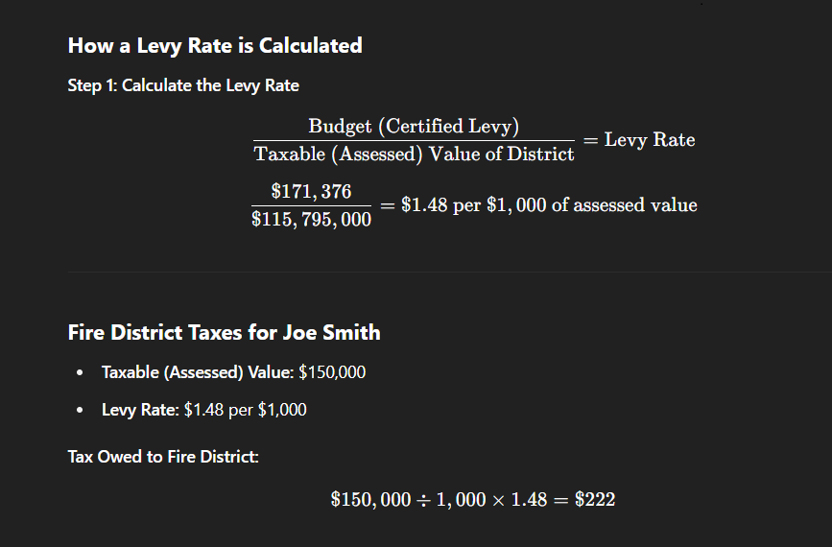
Calculation of a Levy Rate
$171,376 / $115,795,000 = $1.48 per 1,000
(budget) / (taxable value) = (levy rate)
Fire District Taxes for Joe Smith
Taxable (Assessed) Value = $150,000
Levy Rate = $1.48
Rate Calculation
Notes:
In the simple levy process, a taxing district’s budget and assessed value are used to calculate a levy rate.
How do we calculate the levy rate?
The taxing district’s final levy amount is divided by the value of all taxable parcels in the district which then equals the levy rate for the district.
The levy rate is expressed in terms of dollars and cents per $1,000 of assessed value.
How is the property tax dollar amount for an individual parcel calculated?
The parcel’s taxable value multiplied by the taxing district’s levy rate equals the dollar amount of property tax for that parcel.
How do exemptions affect the levy rate?
More exemptions=higher levy rate; shifts the tax burden to non-exempt properties.

Slide 18
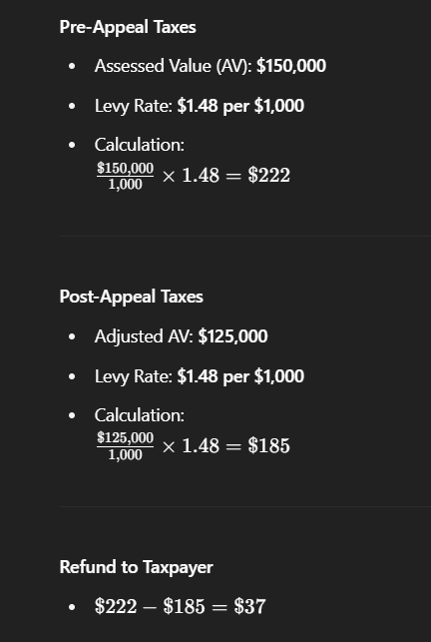
What happens when a value changes?
Example:
The Levy rate has already been certified, when the BOE hears an appeal and reduces the value, resulting in the taxing district not collecting the anticipated full levy amount.
For instance, Joe Smith’s assessed value is reduced from $150,000 to $125,000, and as a result his tax amount is reduced from $222 to $185, requiring a refund to Mr. Smith.
Notes:
When hearings occur after the Assessor has certified the tax roll to the Treasurer the following may occur:
Appeal hearings will be held after the tax roll has been certified and there is no way to correct the roll.
Taxing districts may lose funds since the levy rate is determined and applied to incorrect taxable value amounts for their district.
Taxpayers may have to pay their property taxes on an assessment that is not correct and wait for a refund.

Slide 19
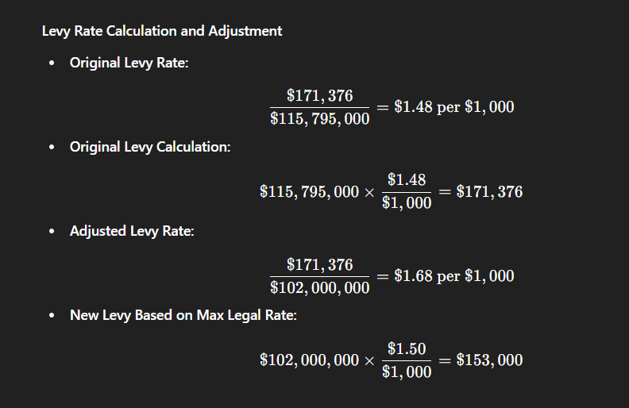
What about our truck?
When multiple appeals are decided after levy rates are set, the impact on a taxing district compounds.
Notes:
Example Scenario:
Certified Taxable Value: $115,795,000
Corrected Taxable Value (post-appeals): $102,000,000
Difference: $13,795,000 in overestimated value
If known earlier:
District could have levied at $1.50 (maximum legal rate)
Instead of the actual $1.48 levy rate based on inflated value
Resulting Revenue Loss:
Expected Levy (at max rate): $102,000,000 × $1.50 ÷ 1,000 = $153,000
Actual Levy (at $1.48 rate): $102,000,000 × $1.48 ÷ 1,000 = $150,960
Revenue Shortfall: $153,000 – $150,960 = $2,040
Refunds Owed to Successful Appellants:
$1.48 × $13,795,000 ÷ 1,000 = $20,416
Original Levy: $171,376
Corrected Levy (after refunds): $171,376 – $20,416 = $150,960
Bottom Line: The district collects $2,040 less than it would have under accurate value and levy conditions. Everyone pays based on an incorrect $1.48 rate, including taxpayers who didn’t appeal.

Slide 20
Assessor Office Overview
Presented by Melissa “Mo” Olivas – Supervisor, County Performance and Administration MelissaO@dor.wa.gov / (360) 534-1425

Slide 21
Responsibilities of the Assessor Office
In Washington State, all real and personal property is subject to taxation unless specifically exempted by law.
Annually updating values on all real and personal property
Per state law, assessor offices appraise property at 100% of its true and fair market value
Real Property – includes land, improvements to land, structures, and some equipment affixed to structures.
Personal Property – includes furnishings, machinery and equipment not affixed to structures, fixtures, supplies, and tools.
Utilize mass appraisal process
Set the levy rates based on the budget requests of taxing districts, the total assessed value of the taxing district, and any applicable levy limitations.
Apply reductions, exemptions and deferrals
Destroyed Property
Current Use program and Designated forest land
Exemptions and deferrals

Slide 22
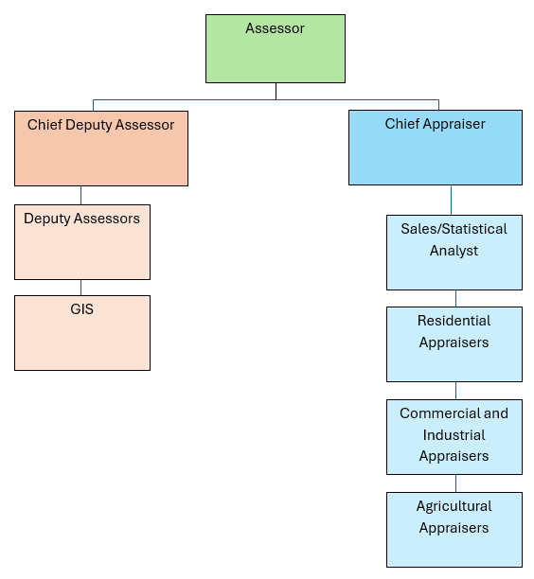
Assessor Office Organization Chart

Slide 23
Exemption Deputy
Personal Property Deputy
Current Use and Designated Forest Land Administrator
Manufactured Home Deputy
Segregation Deputy
Deputy Assessors

Slide 24
GIS, or Geographic Information System.
GIS is a part of the Assessor Office in some counties, but not all.

Slide 25
Appraisal Staff
Sales/Statistical Analyst
Residential Appraisers
Commercial/Industrial Appraisers
Agricultural Appraisers

Slide 26
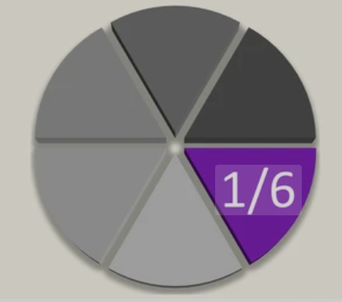
Revaluation/Inspection Cycle
Counties are divided up into revaluation, or inspection, cycles
Most counties are on a six-year cycle.
Two counties are on a four-year cycle.
One area is physically inspected each year, but all values are statistically updated.
Areas may be based on:
School districts or other district lines
Geographic locations and features
Economic factors
Property type

Slide 27
Neighborhoods
Revaluation/Inspection Areas are further divided into Neighborhoods, or Valuation Areas
Neighborhoods may be determined by:
Location
Proximity to amenities, homogenous economic areas, market areas
Property type
Residential, Commercial, Agriculture
Neighborhoods become important when developing market adjustments in the mass appraisal process

Slide 28
What does a revaluation cycle look like?
Appraisers receive their parcel assignments
Inspections and data entry
Sales analysis and market adjustments
Testing of values
New Construction
Change of value notices sent out
30- or 60-day appeal period
Appeals

Slide 29
Appraisers physically inspect all properties within the revaluation/inspection area.
What are appraisers looking for?
Make sure that the characteristics on record are correct
Note any changes to the property
Condition
Updates/Deferred maintenance
Additions/Deletions
Try to talk to the property owner to verify changes
Take updated exterior pictures
Inspections

Slide 30
Data Entry
Most Assessor Offices use a computer assisted mass appraisal, or CAMA, system
Parcels will be updated in the CAMA system with information from the inspections
Many CAMA systems have cost approach software, such as Marshall and Swift, built in
It is very important to have accurate infomation
Update pictures
Update the sketch if changes have been made

Slide 31
Sales Analysis and Market Adjustments
The Sales/Statistical Analyst verifies all sales to determine if they are arm’s length sales
What is an arm’s length sale?
A sale in which a buyer and a seller are unrelated, with no preexisting relationship, and are acting in their own best interest
Examples of possible non-arm’s length sales
Family sale
Foreclosure
Relocation
Estate sale
Using verified sales, market adjustments are determined and applied to all real property in the county

Slide 32
Testing
Counties statistically test values after applying market adjustments
Done to ensure accuracy, consistency, and equity
Checking the values on the sales used to develop the market adjustments
Checking to see if there are any large increases or decreases in value, or if values did not change, and why

Slide 33
New Construction
New construction is put on the rolls every year.
Permits are provided to the county Assessor Office from county and city planning departments
A structure does not have to be 100% complete to be put on the rolls.
Structures may be added to the rolls at a percent complete, as of July 31st of that year
Appraisers follow up on each permit
Measure new construction
Take pictures
Gather as much information as possible for an accurate valuation

Slide 34
Change of Value Notices and Appeal Period
Change of value (COV) notices are sent out to parcel owners
Some counties send COV notices out for every parcel
Some counties send COV notices out for only parcels that have a change in value
The date that COV notices are mailed is the first day of the appeal period
Some counties have an appeal period of 30 days, some a period of 60 days
The assessor office may be very busy during this period talking to parcel owners about their valuations
Appraisers may schedule inspections for properties that may have incorrect information and make adjustment
Gives appraisers the opportunity to explain the process
This is also the time to file appeals

Slide 35
Appeals
Appeals are reviewed
May reach out to property owners for additional information, or to request an inspection of the property
This is the time when, if an adjustment is warranted, a stipulation may be agreed on
If the Assessor Office does Appeal Responses, they will be working on them and submitting to the BOE Clerk

Slide 36
Who, What, When, Where can it be appealed?
Avenues of Appeal
Judicial Appeals
Refunds
Authority of the Assessor
Administrative Appeals
Board of Equalization
Board of Tax Appeals

Slide 37
Judicial Appeals & Small Claims
Judicial appeals (payment of taxes under protest):
Suit must be filed in superior or federal court by June 30th of the following year.
Must list all reasons for protest in writing.
Small Claims: RCW 84.68.110
Maximum amount refundable is $200 per year
Errors in description
Double assessments
Notes:
Judicial appeals (payment of taxes under protest): RCW 84.68.020 & WAC 458-18-215
recourse for those that disagree with their taxes – not free and generally requires an attorney
Suit must be filed in superior or federal court by June 30th of the following year.
Taxes paid under protest must list all reasons for protest in writing.
Non-jury trial
Adverse decisions appealable through the appellate court system.
Refunds bear interest at the short-term U.S. Treasury securities rate
Small Claims: RCW 84.68.110
Petition must be filed within 3 years of the tax becoming payable, filed with the assessor
Maximum amount refundable is $200 per year
Errors in description
Double assessments

Slide 38
Generally issued without a formal claim:
A manifest error or clerical mistake is discovered (e.g., incorrect property description, duplicate billing, or miscalculation).
Taxes were paid on property not legally taxable or on incorrect assessed value.
An exemption or special valuation was mistakenly not applied.
Taxes were collected in error due to administrative oversight.
Refund Reporting: County treasurers are required to report all refunds made under this chapter to the county legislative authority by the first Monday in February each year, detailing the recipient, amount, and reason for the refund.
Administrative Refunds
Notes:
Administrative Refunds: RCW 84.69.020 – for more information contact the county treasurer
Paid more than once.
Due to manifest or clerical errors.
On improvements not existing on the assessment date.
Under illegal or unconstitutional levies.
Based on incorrect assessed valuations.
By individuals who were exempt from property taxes.
On property where the payer had no legal interest.
Following decisions by the Board of Equalization or courts that reduce assessed values.
Generally, a refund claim must be:
Filed with the county treasurer within three years after the due date of the payment
No claim is required for refunds based on specific orders from the Board of Equalization, State Board of Tax Appeals, or courts.
Refunds are typically issued with interest from the date of tax payment. The interest rate is determined based on the average yield of 26-week U.S. Treasury bills as published by the Federal Reserve.

Slide 39
Post-certification value adjustments
Manifest errors: Errors in description, double assessments, clerical errors in extending the rolls,
Stipulated value agreements: Requires timely filed petition to the BOE.
Statutorily Required Adjustments:
Change in Tax Status
Example: property sold to or from a public entity.
Forest Land Designation Changes
Includes the addition, removal, or reclassification of designated forest land.
Special Valuation Adjustments
Multi-family housing under RCW 84.14
Historic property under RCW 84.26
Non-Profit Exemption Determinations
Based on decisions by the Department of Revenue (not the local Board).
Nightclub Sprinkler System Exemption
Valuation Reductions from Government Restrictions
Applies when government action restricts property use or reduces value.
Authority of the Assessor
This Photo by Unknown Author is licensed under CC BY
Notes:
Under RCW 84.48.065(1)(a), a manifest error is a mistake in how a property is listed, not a disagreement over its valuation.
This means the correction doesn’t involve appraisal judgment—we’re not talking about changing the value based on opinion or market shifts.
Think of examples like a typo in the property size, an incorrect parcel number, or the wrong owner listed.
These types of corrections are covered by WAC 458-14-026, and they can be handled directly by the assessor—no Board action is needed.
In summary: These are all updates or corrections that are either clerical in nature or required by statute, and they are handled by the assessor directly. They don’t involve the Board of Equalization and don’t require any action from you.

Slide 40
Any real or personal property improvement that has lost value due to the impact of a natural disaster or involuntary destruction.
What it does:
Provides a reduction in assessed value when the destruction results in a loss of more than 20% of the property’s market value.
Offers abatement (forgiveness) of property taxes for the portion of the year after the destruction occurred.
How it works:
The assessor calculates the reduction in value.
Taxes are reduced proportionally for the remainder of the year.
If taxes have been paid in full, the difference is refunded to the taxpayer.
What’s Not Covered
Voluntary demolition or destruction (e.g., tearing down a building by choice).
Instead, that value is removed from the next year’s assessment roll, not the current one.
3-Year Exemption for Rebuilding
A separate exemption is available for single-family homes destroyed by a qualifying natural disaster:
3-year exemption on the value of new improvements added during rebuilding.
The exempted value cannot exceed the value of the destroyed portion.
Destroyed Property
Notes:
Eligibility :
Property must be involuntarily destroyed (e.g., fire, flood, natural disaster).
Property must have been on the assessment roll as of January 1 of the year it was destroyed.
Damage must result in a loss of more than 20% of the property's market value.
Tax Relief:
Abatement of taxes for the year of destruction (full or partial).
Refund of taxes already paid, based on the reduced value.
Application Process:
“Claim for Reduction of Assessments on Destroyed Property" filed with the county assessor.
Must be filed within three years of the destruction date and may be on the Assessor’s motion.
Include supporting documentation, such as fire reports, insurance claims, or contractor estimates.
To summarize, the only aspect appealable to the Board of Equalization (BOE) is the percentage of value reduction applied by the Assessor due to property destruction or damage.

Slide 41
Exemption Status
Exemption Status
The assessor may adjust the exemption status of property with respect to:
Senior citizen exemptions (WAC 458-16A-135),
Sale to or by a government entity, or
Physical improvements to single family dwellings (RCW 84.36.400 & WAC 458-16-080).
Heavy Equipment Rental Exemption.
The decision to deny and the level of exemption is appealable to the BOE.
Notes:
Senior citizen exemptions (WAC 458-16A-135),
Sale to or by a government entity, or
Physical improvements to single family dwellings (RCW 84.36.400 & WAC 458-16-080)

Slide 42
Administrative Appeals:
1. Start with the County Assessor
If taxpayers disagree with the assessed value, they can file a petition to appeal.
2. File a petition with the BOE
Parties submit evidence supporting their claim (e.g. sales, condition issues).
BOE holds a hearing (in-person, by phone, or written submission).
BOE issues a written decision.
3. Appeal BOE Decision to the BTA
If unsatisfied with the BOE decision, the taxpayer (or assessor) can appeal to the Board of Tax Appeals (BTA).
Deadline: File within 30 days of the BOE decision mailing date.
BTA conducts a de novo hearing (new hearing, not a review of the BOE).
* The BTA may:
Affirm the BOE’s decision,
Modify the value,
Reverse the ruling.
4. Further Appeal – Superior Court
After the BTA decision, either party can appeal to Superior Court.
This is a judicial review and follows court procedures.
Exemption Status
Notes:
Administrative appeal pathways available to taxpayers:
The standard process begins with the taxpayer filing an appeal with their local Board of Equalization, or BOE.
If the taxpayer disagrees with the BOE’s decision, the next level of appeal is the Board of Tax Appeals—or BTA.
In some cases, there is a path for a ‘Direct Appeal’—where a taxpayer skips the BOE and goes straight to the BTA.
But this isn’t automatic or commonly granted.
And lastly, if a party is dissatisfied with the BTA’s final decision in a formal appeal, they may take the case to Superior Court. This judicial review is part of the taxpayer’s due process rights but is used more sparingly, as it’s a more formal and resource-intensive route.

Slide 43
Jurisdiction
Boards of Equalization
Board of Tax Appeals
Jurisdiction involves appeals of Assessor determinations, including:
Changes in assessed value
Exemption denials, cancellations, or removals:
Multi-unit dwellings in urban centers
Historic property
Senior citizen or disabled exemptions
Department-determined exemptions
Special sprinkler system exemptions
Current Use & Designated Forest Land issues:
Application denials or removals
Farm/agricultural land status changes
Destroyed property reductions
Omitted property or value
Valuation reductions due to government restrictions
Limited Income Deferral Program
Manifest errors resulting in roll corrections
Jurisdiction involves decisions from the Department, or from the BOE, including:
Appeals from County Boards of Equalization (BOEs)
State-Assessed Property:
Intercounty utilities and private car companies
Equalized valuations and apportionments by the Department
Department Decisions:
Exemption denials
Current use valuation interest rates
Stumpage value tables
Appeals from DOR Orders under general supervision authority.
Other Specific Appeals:
Sale price of second-class shorelands
Urban redevelopment tax districts
Appeals under RCW 84.40.038 (untimely or incomplete)
Notes:
The BOE may hear the following types of property tax-related appeals:
Valuation Disputes
Appeals of appraised value used to establish taxable rent under leasehold excise tax – [RCW 82.29A]
General valuation appeals – [RCW 84.48.010]
Exemption and Deferral Disputes
Cancellation of urban multifamily exemption – [RCW 84.14.110]
Historic property decisions – [RCW 84.26.130]
Senior citizen exemption denials – [RCW 84.36.385]
Cessation of exempt use (value determination) – [RCW 84.36.812]
Exemption for nightclub sprinkler systems – [RCW 84.36.660]
Property tax deferrals – [RCW 84.38.040]
Limited income deferral denials – [RCW 84.37.040]
Appeals of exemption claims for real or personal property – [RCW 84.48.010]
Land Classification Disputes
Forest land application denial – [RCW 84.33.130]
Forest land removal – [RCW 84.33.140]
Current use determinations or removal – [RCW 84.34.035, RCW 84.34.108]
Other Assessment-Related Appeals
Valuation reduction due to government restriction – [RCW 84.40.039]
Omitted property or value – [RCW 84.40.085]
Correction of manifest error affecting rolls – [RCW 84.48.065]
Destroyed property valuation adjustments – [RCW 84.70.010]
BTA appeals may include:
Appeals from County Boards of Equalization
First, taxpayers who disagree with their county board's decision can appeal to the BTA.
These usually involve assessed property value disputes.
It’s a second chance for property owners or assessors to have their case reviewed.
2. State-Assessed Property Disputes
The BTA handles appeals involving state-assessed property—like intercounty utilities or private car companies.
This includes challenges to how values are equalized and divided among counties.
3. Department of Revenue Decisions
This is a broad area. The BTA hears appeals from decisions made directly by the Department of Revenue.
That includes tax assessments, exemption or deferral denials, and even refund rejections.
It also covers appeals involving interest rates for farmland valuation under the current use program and stumpage value tables used for timber.
4. Appeals from DOR Orders under RCW 84.08.010 and RCW 84.08.060
In some cases, an assessor or property owner can appeal a specific DOR order directly to the BTA.
These must generally be filed within 30 days of the DOR’s mailing.
5. Other Specific Appeals
A few more niche appeals, like:
Disputes over the price of second-class shorelands,
Tax apportionment decisions in urban redevelopment zones,

Slide 44
Boards of Equalization
Must have at least 3 members, with up to 4 alternates to cover absences or resignations.
Members are usually volunteers serving 3-year terms, some counties have term limits.
Appointed by the Board of County Commissioners
Business is conducted during the “Regularly Convened Session” where the Board:
Hears appeals on most assessor decisions
Equalizes property values to 100% true and fair market value
The Board does not decide questions of law.
Clerk manages the appeal process from petition receipt to order distribution.
Notes:
Responsibilities
Provide an impartial hearing that protects due process rights and ensures a fair decision.
Determine if there is sufficient relevant evidence to support the appellant’s claim.
Weigh facts presented; do not conduct independent research or investigations (no tours or searching for comps).
It’s acceptable to ask clarifying questions during hearings to better understand the evidence.
Parties are responsible for submitting all evidence; the Board does not act as a detective.
Decisions must be made based on the evidence provided — incomplete evidence means the appellant cannot prevail.
Equalization:
Boards examine and compare assessments to see if comparable properties are comparably valued without an appeal.

Slide 45
Board of Tax Appeals
Comprised of 3 members (Chair, Vice Chair, Member) serving 6-year terms appointed by the Governor, supported by tax referees.
Hears appeals “de novo” — not limited to prior evidence
Parties may submit new arguments, testimony, and evidence
Uses same standards of review as county boards
Original certified value presumed correct
County board values do not have presumption of correctness
Appeals may be formal or informal.
Notes:
Types of Appeals the BTA Handles
Appeals of Board of Equalization (BOE) orders.
Decisions made by the Department of Revenue, including:
Direct Appeals that skip the BOE (explained further on the next slide).
Appeal Options
Formal Appeals:
Typically used when discovery is needed, protective orders are sought, or legal rulings are required.
Decisions can be appealed to Superior Court.
Informal Appeals:
Make up about 90% of cases.
Usually handled by taxpayers representing themselves (Pro Se).
Decisions are final.

Slide 46
Direct Appeals…a group project.
Parties:
Board of Equalization:
BTA:
Timely and complete petition pending the BOE.
May be requested by Taxpayer or Assessor.
Both must sign and give request to BOE.
Must approve or deny with majority vote.
Only for complex issues beyond the expertise of BOE.
Not for conflict of interest.
Will only grant in cases of Highly Valued Disputed Property.
Amount in dispute exceeds ¼ of 1% of the county value.
Denied requests are remanded to the BOE.
Notes:
Requires timely, complete petition filed with the BOE.
May be considered for appeals with complex issues beyond BOE purview.
Taxpayer, BOE Members, Assessor (or designee) must all sign the request.
BTA will approve or deny request by simple majority vote within 15 days of receipt.
If denied, appeal goes back to BOE for consideration.
First the taxpayer needs to have a timely and completed petition in with the BOE. And then it requires the signatures of not just the taxpayer but the BOE members and the assessor as well. This isn’t going to happen for your every day real property valuation appeal, do not pass go, do not collect $200. Direct appeals are typically for issues beyond board of equalization acumen.
The BTA will determine whether or not to approve the request by majority vote within 15 days of receipt. If the request is denied, the original appeal goes back to the board of equalization to hear.

Slide 47
The Appeal Process – Step-by-Step
Step 1: Receiving the Appeal
Step 2: Review of Appeal
Step 3: Informal Resolution
Step 4: Preparing for the Hearing
Step 5: Hearing
Step 6: Decision

Slide 48
Appealing to the BOE
Requires:
A properly completed and timely filed taxpayer petition.
Who Can File?
Property owner or person responsible for paying the taxes.
Authorized representatives (with signed authorization connecting them to the taxpayer).
Lessees, if legally responsible for taxes under contract.
Notes:
Clerk responsibilities:
Must provide the Assessor’s Office with a copy of the petition and all attachments.
If not, the Assessor won’t know an appeal was filed.
If the valuation information box is checked, the Assessor has a deadline to respond to the taxpayer.
Valuation questions:
The BOE does not answer these.
Must be discussed between the taxpayer and the assessor.
Definition of "Taxpayer" (WAC 458-14-005(22)):
Name on the assessment rolls or their authorized agent.
Also includes new owners not yet updated in county records due to error or delay.
If the owner has a representative, they should provide a copy of their authorization forms.
Check to ensure it connects the representative to the taxpayer.
Double check the taxpayer signed it

Slide 49
Essential Elements
Timely Filed
Complete
We can’t tell
Prior to July 1.
Within 30 (or 60) days of mail date for “notice” or “decision”.
Answers to all relevant questions on the form.
Sufficient information to apprise the board and assessor of the reasons for the appeal.
DOES NOT need ANY documentary evidence.
Missing Agent Authorization, Notice of Personal Representative.
Assistance on Jurisdiction.
Notes:
Reminder: A Change of Value Notice must be sent if the assessed value of a property changes from the previous year, as determined by the assessor.
Filing deadlines (WAC 458-14-056):
July 1 of the assessment year,
Or 30 (up to 60 days) after the COV is mailed (petitions filed after July 1st, MUST have a copy of the revaluation notice attached).
Complete Petitions (WAC 458-14-056(5)):
Documentary evidence is not required for a petition to be complete.
Verify the Basic information (p. 1) of the real property petition form off the NOV.
Reason for appeal is the only subjective requirement.
Copy of COV notice when filed after July 1^{st.}
Copy of POA or other authorization if person filing isn’t the taxpayer.
Incomplete Petitions:
Petitions that only state vague reasons (e.g., “The Assessor’s value is too high” or “The taxes are excessive”) are incomplete.
Incomplete petitions will be returned with a request for missing information, with a deadline to correct.
Non-compliance may result in dismissal, which can be appealed to the BTA.

Slide 50
What is being appealed?
Is it timely?
Refer to WAC 458-14-056(2)(a–c)
Verify with Notice of Value (NOV) or similar document.
Is it complete?
Use WAC 458-14-056 as a checklist for required information.
Is the reason for appeal something the Board can hear?
Reminders
If untimely or incomplete, taxpayers must be given a chance to correct the issue.
Sometimes, incompleteness prevents verifying timeliness.
Administrative efficiency should not override due process.
When information is missing or incorrect:
Provide clear instructions for correction.
Include a clear deadline.
Must be in writing and retained for the file.
Base decisions on the facts provided, not assumptions.
Key Questions

Slide 51
A timely hearing must be scheduled for all petitions which have not stipulated or withdrawn.
When scheduling or rescheduling: 22 is the “magic” number!
Parties may agree to less notice – in writing!
Evidence Exchange:
Parties each send evidence supporting their position to the other side AND the Board.
Deadline is 21 business days prior to hearing.
May be electronic or hardcopy – BOE preference.
Untimely Evidence or additional evidence at the hearing:
The opposing party may object, and the board makes a ruling to accept or deny the evidence.
If the additional evidence is allowed, it must be provided to the board and the opposing party, then the opposing party must be allowed time to rebut.
Scheduling & Evidence
Notes:
Hearing Notice Requirements (WAC 458-14-076(2))
Include the following details:
Appellant’s name
Hearing date, time, and location
Estimated hearing duration
Account or parcel number
File number (assigned by the clerk)
Any additional instructions to help the parties understand the hearing process
Your scheduling/rescheduling policy (recommended if one does not exist)
Inform both parties that all evidence must be submitted to the BOE and the opposing party at least 21 business days before the hearing.
The clerk must keep a copy of the hearing notice in the official appeal file.
Valuation Information (WAC 458-14-066)
If the valuation box on the petition is checked:
The Assessor must provide the valuation information used to assess the property within 60 days of the request, but no later than 21 business days before the hearing.
This provides taxpayers with insight into how they developed the value (the more taxpayers understand, the less likely they are to continue). Box on the petition form.
Evidence Exchange Requirements (WAC 458-14-087)
Taxpayers must submit their valuation evidence to both the Assessor and BOE at least 21 business days before the hearing.
The Assessor may respond with rebuttal evidence, which must also be shared with both the taxpayer and BOE at least 21 business days in advance.

Slide 52
Stipulation & Withdrawal
When the parties reach an agreement, they can choose to stipulate IF;
The assessment roll has been certified,
The taxpayer has a timely filed petition,
There has not been a hearing, and
Both parties have signed the stipulation.
Taxpayers may withdraw their petition when:
The request is made in writing (email is acceptable),
The request is submitted no later than 2 days prior to a hearing, unless the board allows a later withdrawal.
Notes:
Stipulations (WAC 458-14-026)
Withdrawals (WAC 458-14-076)

Slide 53
Presumption of Correctness
The Burden of Proof
Clear, Cogent, & Convincing:
All valuation appeals start at this standard.
May be overcome if evidence shows it is highly probable the assessed value is incorrect.
The facts are clear, positive, and unequivocal in their implication.
When taxpayers meet this burden, shifts to preponderance on those issues.
Preponderance:
All non-valuation appeals start at this standard.
May be overcome by evidence showing the issue is more likely than not (50% + anything).
The original value is presumed to be
correct.
RCW 84.40.0301
Notes:
In a valuation appeal, the evidence must indicate it is highly probable the certified value is incorrect AND what the value is.
If successfully overcome, the standard of proof shifts to the preponderance of the evidence, must now prove it is more likely than not that the value is wrong.
The standard of clear, cogent, and convincing evidence changes to a preponderance of the evidence in the following situations:
Values have been corrected: For example, if the Assessor recommends a reduced value to the Board of Equalization (BOE).
Valuation methods have been invalidated: For example, if the taxpayer demonstrates depreciation not applied when using the cost approach.
The Assessor admits error: If the Assessor acknowledges a mistake, this serves as clear, cogent, and convincing evidence that the original assessment was flawed. In this case, the standard shifts to preponderance of the evidence.
The issue is not a valuation issue: For example, in cases of current use removal, where the decision is typically a simple yes or no.
Finally, it is important to remember that the taxpayer has a two-part obligation: they must prove both an error on the part of the assessor and the specific amount of the value adjustment. If the taxpayer fails to do this, the Board must use its judgment to determine how much, if any, adjustment is appropriate.

Slide 54
Oath of Truthfulness: “Do each of you who will be testifying today affirm that the testimony you will give will be the truth?”
Opening remarks:
Introductions of the Board members, taxpayer, and assessor or the assessor’s representative.
Then cover the separation of the board & assessor’s office
The board’s duty/authority
The presumption of correctness
What is considered proper evidence
Inform parties of testimony time limits
The board’s decision-making procedures
Appeal rights (to BTA)
All hearings are open to the public.
Clerks must attend and record all hearings.
Chair controls the hearing and ensures fairness of process.
Hearings
Notes:
All who testify shall swear or affirm to tell the truth under penalty of perjury WAC 458-14-076(4).
Includes: taxpayer, assessor’s representative, and any witnesses
May be given individually
May be given to everyone offering testimony
May be administered by the clerk or chairperson
RCW 84.48.028 – Clerk is required to attend all hearings
All hearings are required to be recorded with an audio recording device WAC 458-14-095(1).
open to the public unless a party requests that part or all of the hearing be closed due to confidential income data evidence.
Note that an observer is there to do just that, observe, they should not interject.
Sign-in sheets are recommended to provide the board a record of the names of those testifying.
WAC 458-14-095 – Confidential Information
Hearings involving confidential information must be recorded separately.
Confidential information must be kept in a sealed file labeled “confidential”.
Confidential information testimony is closed to the public, so let any observers know the hearing will be closed for that portion.

Slide 55
Evaluating Testimony & Evidence
Is it relevant?
Does the information relate directly to the value of the property?
Does it make a fact more or less likely to be true?
Is it credible?
Is the source trustworthy and knowledgeable?
Does the testimony align with the supporting evidence?
Is it sufficient?
Has enough evidence been presented to overcome the presumption that the assessor's valuation is correct?
Notes:
Examples of relevant evidence include:
Comparable sales
Cost or income data
Maps or photographs
What is not evidence:
Arguments: Attempts to persuade (e.g., citing laws, prior court cases)
Legal references: Statutes, rules, or case law are general principles—not factual evidence

Slide 56
Board Reviews
How to Prepare!
Communicating with your members.
Standards and Expectations.
Notes:
The Department of Revenue is the state agency charged with the responsibility of statewide administration of the property tax system.
The Department's broad authority over county officials in general and local boards of equalization includes:
Acting as the oversight agency. (RCW’s 84.08.010, 84.08.060)
Administration of state property tax system. (RCW’s 84.08.010, 84.08.060)
Providing education and guidance (RCW’s 84.48.042, 84.48.046)
Why do you think we do county reviews?
Part of our job to administer the property tax system is to provide education and guidance to county officials and boards of equalization.
BOE reviews are one of the tools we use to accomplish that task. They help us to see the processes of the county boards and we use that information to provide education to help the boards improve their processes.
We are here to help you successfully implement the law. Which helps to eliminate risk for the county. (AGO acts as legal counsel for DOR)
I’ve watched two property tax hearings since I’ve been with the Department. You do not want to have to deal with that, it’s a great deal of extra time, money, and stress.

Slide 57
Clerk
Administrative & Procedural Support
Receive and Review Appeals
Schedule Hearings
Support During Hearings
Record Decisions and Notify Parties
Ensuring legal compliance by parties and Boards.
Acts as a neutral liaison between the public, the Board, and the assessor’s office.
Provides general guidance (not advice) to appellants about the process.
Maintains records.
Notes:
Key Functions:
Neutral Facilitator: The BOE Clerk serves as a neutral party, ensuring the appeals process is fair, transparent, and compliant with legal standards.
Administrative Backbone: The Clerk manages the administrative tasks that support the Board’s decisions on property valuations and exemptions.
Public Interface: Clerks often serve as the point of contact for appellants, providing guidance on the appeals process and maintaining communication with all parties.
Core Responsibilities:
Receive and Review Appeals
Accepts appeal petitions from property owners challenging their valuation or exemption status.
Verifies completeness and timeliness of appeals (typically due by July 1 or within 60 days of the valuation notice).
Logs and tracks cases in a docket or management system.
Hearing Coordination and Support
Coordinates hearing dates with BOE members.
Notifies appellants and the assessor’s office.
Sends formal hearing notices and ensures all parties are aware of evidence submission guidelines.
Attends hearings to:
Take notes & record proceedings.
Ensure procedural fairness.
Help the Board reference rules or documents.
Post-Hearing Decisions
Drafts decision letters based on Board rulings.
Sends determinations to both the appellant and the assessor’s office.
Updates case status and records final outcomes.
4. Compliance and Records Management
Maintains awareness of applicable RCWs, WACs, and Department of Revenue guidance.
Follows strict procedures to avoid bias or procedural errors.
Ensures appeal files are stored securely and in compliance with public records retention laws.
Prepares documentation for audits or the Board of Tax Appeals if needed.

Slide 58
Help is here!
Forms and Publications
To Share with others:
Available in:
Spanish
Russian
Korean
Vietnamese
Chinese
Publications on:
Appeals
Current Use
Exemptions
Levies
Refunds
Property Tax Forms
Property tax is the oldest tax levied in the state of Washington, and it’s also one of the more difficult to understand. Property taxes are essential for funding local services such as fire protection, libraries, parks and recreation, and public schools. Watch our Understanding Property Tax video(opens in a new window) and learn the basics of property tax.
Notes:
The PTRC is a great resource, however, it is for county officials use only.
We do not give the web address to taxpayers. The information on the website is public information, but it also contains contact information for county officials that they may not wish to have published. It also has the DOR’s forms listed, and some counties don’t use those forms or have updated the forms. It’s ok to update the forms, if you have obtained approval from the Department.
Look past BOE Reviews on the PTRC, they are a good source of information.
It’s a good idea to become familiar with the online County BOE Manual available on the Department’s website.

Slide 59
2025 Reviews
Snohomish
Thurston
Follow-ups in progress:
Adams
Asotin
Ferry
Franklin
Island
King
Kitsap
Lincoln
Okanogan
Skamania
Walla Walla
Whatcom
Notes:
What is the process for BOE reviews?
The auditor will:
Contact the clerk to determine a date and time for an interview for the review.
Request a list of petitions, the list should include:
The petition #, was determination overruled/sustained?
For valuation or non-valuation issue, was petition withdrawn?
Choose the petition files for review.
In addition to the petition files, the clerk will provide form letters, custom forms, hearing notices, and the certification from the assessor to the board.
The clerk provides the Department with the petition files electronically.
Conduct a phone or online interview with the clerk.
Review the information gathered and draft a review report.
Send a draft copy of the report to the clerk.
The board will have two weeks to ask questions or provide input.
Issue the final review report.

Slide 60
Common Issues
Incomplete Documentation
Untimely Actions
Administrative
Petition file did not include a value notice or other determination (RCW 84.40.038 and WAC 458-14-056)
Record of hearing not completed and published (WAC 458-14-095(5).
Accepted appeals without appropriate documentation or reasons.
Did not request to reconvene after the regular 28-day session.
Began regular 28-day session at the incorrect time.
Denied good cause or reconvene inappropriately.
Clerk did not attend hearings (RCW 84.48.028).
Meeting dates not published (WAC 458-14-056).
BOE website inaccurate or out of date.
Notes:
Common issues found in our reviews:
Petition file did not include a value notice or other determination (RCW 84.40.038 and WAC 458-14-056)
The Board must require a copy of the assessor’s value notice or other determination when petitions are submitted after July 1 of the assessment year.
Clerk did not attend hearings (RCW 84.48.028)
The law says, the clerk shall attend all sessions and keep the record.
Confidential information (WAC 458-14-095)
Confidential information must be kept in a separate envelope, marked Confidential Evidence, labeled with the case number, sealed from public inspection.
Meeting dates not published (WAC 458-14-056)
The Board should publish the dates of the three required meetings in the Assessor’s Office, courthouse bulletin board, and newspaper, using the Notice of Meeting of County Board of Equalization form. (REV 64 0050)
Record of hearing not completed and published (RCW 84.48.010 and WAC 458-14-095(5))
Complete the Board Clerk’s Record of Hearing form (REV 60 0002), include it in each appeal file, and publish it in the same manner as the proceedings of the county legislative authority are published.
Request to reconvene after the regular 28-day session
The Board must request and receive approval from the county legislative authority to convene after their regular 28-day session to hear timely filed petitions.
BOE website
Taxpayers should have direct access to the Board’s website, in addition to access via the assessor’s office.
Control Register
The clerk should maintain a petition log of all submitted petitions. The log should include the information necessary to track the status of each petition throughout the appeal process.

Slide 61
Laws, Standards, and Ethics for BOE Members
Callie Barrett
Andrew Krawczyk
Assistant Attorneys General Revenue and Finance Division
Disclaimers:
The opinions expressed at or through this presentation are our own. They are not the official position of the Department of Revenue or the Washington State Attorney General’s Office.
We are not providing legal advice. This presentation is intended for educational purposes only. It does not replace independent professional judgment or advice from your county prosecuting attorney.

Slide 62
Agenda
Doing the Job
Standards of Review
Ethics
Hearing Tips
BOE Authority
Laws and Rules

Slide 63
Boards of Equalization (BOE) Who are you? What authority do you have?

Slide 64
A quick civics refresher …
The constitution sets forth 3 branches of government, each intended to carry out specific duties
These branches are intended to check and balance one another
We refer to this as the “separation of powers”

Slide 65
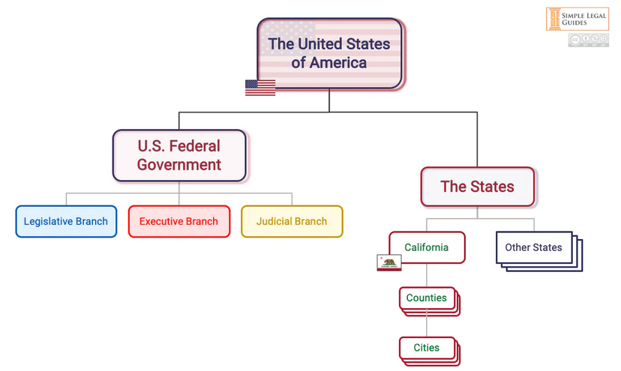
Quick Civics Refresher Part 2: Layers of Government

Slide 66
Structure of State Government
Legislative
State House of Representatives State Senate
State Agencies
e.g., Department of Revenue
State Boards and Commissions
e.g., Board of Tax Appeals
Independent Elected State Offices
Attorney General Secretary of State
Executive
Governor
Judicial
State Supreme Court
Courts of Appeal
(3 Divisions)

Slide 67
BOE’s Legal Authority comes from the State Legislature
BOEs are county-based
Counties are subdivisions of the state of Washington, created by the state legislature.
Counties have only the powers specifically granted to them by the state. They exercise those powers through the county-level legislative body: County Commissioners or County Council (charter).
Counties can only levy taxes specifically authorized by the state legislature.
Counties are empowered to create Boards of Equalization (RCW 84.48.010), but not to set their powers.

Slide 68
So what is the BOE? (in a nutshell)
The Board of Equalization is a county level agency, responsible for reviewing and adjusting the County level property tax assessments to ensure fairness, uniformity and accuracy.

Slide 69
Structure of County Government
Powers are delegated by and/or subject to state authority
Legislative
County Commissioners
(County Council)
County Departments e.g., Department of Planning
County Boards and Commissions
Board of Equalization
Independent Elected County Offices
Assessor Treasurer
Executive
County Commissioners
(County Executive)
Judicial
County Municipal and Superior Courts

Slide 70
BOE’s Authority
The BOE has only the powers specifically granted to it by the State Legislature (county cannot grant more than was given to it).
Functional control granted to the Department of Revenue (RCW 84.48.046, 84.08.060)
Day-to-day operations might be set by county or left to the BOE itself.
BOE operates by agreement, within the authority of statute (RCW 84.48), administrative rules (WAC 458-14), and Department of Revenue instructions:
By policy or by “meeting by notice” & vote (OPMA)
https://www.atg.wa.gov/lesson-3-open-public-meetings-act-rcw-4230
Municipal Research and Services Center https://mrsc.org/explore-topics/legal/open-government/open-public-meetings-act

Slide 71
Jurisdiction is limited
The Legislature sets the BOE’s authority (“jurisdiction”) to review different kinds of decisions (typically those made by the Assessor) or to take specific actions.
See WAC 458-14-015 for full list

Slide 72
What can the BOE do?
The BOE has authority (“jurisdiction”) to resolve issues related to the Assessor’s actions
-This authority is set out by STATUTE, enacted by the Washington legislature.
-Your job, in essence, is to decide whether the Assessor’s valuation (or decision related to valuation) was correct.
See RCW 84.48.010 (Assessor’s determination of market value)

Slide 73
What the BOE cannot do?
BOE does not have the authority to address:
Whether the Assessor is doing their job right
Whether a county official has trespassed on a taxpayer’s property
Whether property taxes are unconstitutional
Unconstitutional treatment by the Assessor (lack of due process)
Whether one of the parties should pay the other’s attorney’s fees or costs
Waiver of deadlines for appealing to the Board except as expressly authorized by statute
Equity issues (“fairness” “justice”)

Slide 74
Q: Why can’t BOE hear these issues? A: They are resolved by other levels and/or branches of government
Whether the Assessor is doing their job right
Assessors are independently elected; they can be voted out at the next election if voters don’t approve
OR if the Assessor breaks the law, the courts would resolve such an issue
Whether a county official has trespassed on a taxpayer’s property
Courts decide
Whether property taxes are unconstitutional; whether Assessor violated due process
Courts decide whether the Legislature’s tax statutes are unconstitutional and whether there has been a due process violation
Whether one of the parties should pay the other’s attorney’s fees or costs
Some statutes authorize courts to award attorney fees, depending on the case
Waiver of deadlines for appealing to the Board except as expressly authorized by statute
BOE cannot waive deadlines set by the Legislature
Equity issues (“fairness” “justice”)
Courts have authority to order certain remedies

Slide 75
Doing the Job

Slide 76
Key questions
What am I deciding? What is the “relief” requested? Do I have the authority to decide the issue/grant the relief? What is the disagreement?
Who is responsible for providing persuasive evidence and arguments (“burden of proof”)? What evidence (kind, degree) is necessary? What facts are relevant?
What legal “standard” must be met for me to decide the issue/grant the relief? What level of certainty is necessary to decide the issue/grant the relief?
How do I weigh the evidence? What makes evidence credible? Is evidence a “fact?” What facts are necessary to decide an issue?

Slide 77
What am I deciding?
What’s the “relief” requested?
What does appellant/petitioner want?
Sometimes it’s hard to figure out. You can ask, “what will solve the petitioner’s problem (or make it better for them)?”
Did they ask for that (or get close?)
Do you have the authority to do it?
What are the issues that need resolution/what is the disagreement?
Is it about the facts (e.g., What was the color of the stoplight?)
Is it about the meaning of the facts (e.g., Did the yellow light provide the driver a warning?)
Is it about the law (e.g., Is a driver is required to stop for a yellow light if it’s possible to do so?)

Slide 78
Who has the “burden of proof”?
The party seeking relief has the burden of proof. It’s almost always the taxpayer, with rare exceptions:
Assessor reconvene
Equalization
Burden of proof has two elements:
Burden of Production – Someone has to go through effort of rounding up and presenting evidence. No evidence, no relief.
The evidence must be relevant – that is, it must tend to make the item at issue more or less likely to be true/accurate.
Burden of Persuasion – The evidence must tell a story that is sufficiently convincing.
How convincing depends on the applicable “standard of proof.”

Slide 79
Standards of Proof

Slide 80
Scintilla
Any evidence at all. Even the smallest measurable amount of evidence.
A mere spark, gleam, glimmer.
The burden is met by a very insignificant or trifling item of evidence.

Slide 81
Reasonable Suspicion
A claim or assertion based on specific or particular articulable facts or reasons. Not based on a hunch or guess.
The level of certainty/degree of evidence needed for an officer to “stop and frisk” someone.

Slide 82
Probable Cause
A reasonable and trustworthy basis for a prudent and ordinary person to believe that something has occurred.
The level of certainty/degree of evidence needed for an officer to arrest someone or obtain a search warrant

Slide 83
Preponderance of Evidence
The greater weight or amount of evidence, more likely than not that the person is correct about claim or assertion (i.e., 50% + 1 scintilla)
The level of certainty or degree of evidence needed to win an automobile collision case (and most other civil cases).
50/50
+ 1 scintilla

Slide 84
Clear, Cogent and Convincing
A firm belief or conviction that the allegation or claim is true.
the level of certainty or degree of evidence for letting the State take a child away from a parent

Slide 85
Beyond a Reasonable Doubt
No other logical explanation can be derived from the facts except that the claim or assertion is true. Requires elimination of every reasonable doubt.
the level of certainty or degree of evidence needed for the State to convict someone of a crime.

Slide 86
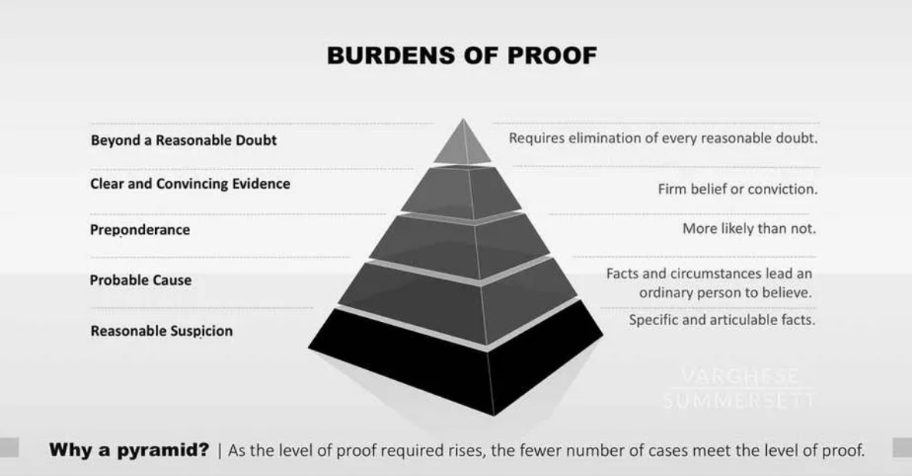

Slide 87
Standards of Proof – The BOE’s Two
Clear, Cogent, and Convincing
The totality of the evidence must leave you with the firm belief or conviction that the claim is correct.
Valuation cases - The law presumes that an assessor’s valuation is correct.
It is not enough for the taxpayer to provide evidence to show that another value is possible.
It is not enough for the evidence to suggest that the assessor could be wrong.
The taxpayer has to convince you that the assessor’s value is wrong AND that the taxpayer’s alternative value is right.
Usually, the same evidence does both at the same time.
Preponderance of the Evidence
The totality of the evidence suggests that the claim is more probably true than not true.

Slide 88
Weighing the Evidence
What is evidence?
Testimony – statements by a person
In person testimony
Testimony by affidavit or declaration
“Documents”
For example, word documents, pictures, spreadsheets, emails, deposition excerpts, sound recordings

Slide 89
Weighing the Evidence, continued
Hearsay
An out-of-court statement offered to prove the truth of the matter asserted of a statement made by a person who is not present.
Problem with hearsay is that we can’t be sure that’s what was really said. It was said out of court and the speaker isn’t here to verify it.
You don’t need to worry about hearsay and all its exceptions because you are an administrative tribunal. You may consider testimony or documents that include an out-of-court statement.
For example, the BTA uses this standard:
“All relevant evidence, including hearsay, is admissible if, in the opinion of the board, it is the kind of evidence that a reasonably prudent person is accustomed to relying on his or her business affairs.” WAC 456-09-755

Slide 90
Weighing the Evidence, continued
Look at the Totality of the Evidence
The taxpayer has the burden of bringing forward evidence to prove their claim.
The Assessor is entitled to provide evidence to dispute the evidence presented by the taxpayer.
After reviewing the evidence of both parties, considering the assessor’s presumption of correctness (if applicable), has the standard of proof been met?
But Set Aside Evidence That is Not Relevant
Relevant evidence is that which tends to prove or disprove the issue(s) you’ve identified for resolution. If it is not related, it does not play a part in the decision.

Slide 91
Convincing Evidence
Give Weight to Factual Evidence
Does the evidence tend to prove or disprove a fact, or is it a disguised (or not-so-disguised) opinion, assumption, or inference?
Opinions are (generally) not evidence and not facts. YOU might (or might not) reach the same conclusions as the person opining, but you must base your conclusions on the evidence provided and the facts proved by that evidence.
Give Weight to Reliable Evidence
Evidence that due to its type, source, etc. is likely to be accurate and/or true
Give Weight to Credible Evidence
Believable testimony - Consistent with established facts or other credible evidence? Apparent falsity?
Believable documents – The document is what it purports to be

Slide 92
Evidence of Value – Admissibility and Weight
(1) In making its decision with respect to the value of property, the board shall use the criteria set forth in RCW 84.40.030.
(2) Parties may submit and boards may consider any sales of the subject property or similar properties which occurred prior to the hearing date so long as the requirements of RCW 84.40.030, 84.48.150, and WAC 458-14-066 are complied with. Only sales made within five years of the date of the petition shall be considered.
***
(4) More weight shall be given to similar sales occurring closest to the assessment date which require the fewest adjustments for characteristics.
WAC 458-14-087; see also RCW 84.40.030

Slide 93
Ethics

Slide 94
Good Guide for Ethics
Uphold the independence, integrity and impartiality of the Board, and avoid impropriety and the appearance of impropriety.
Perform the duties of the Board, impartially, competently, and diligently; and
Conduct the personal/business activities in a way which minimizes the risk of conflict with the Board obligations
Adapted from the Office of Administrative Hearings –
Code of Ethics for Administrative Law Judges
https://oah.wa.gov/Portals/0/Content%20Area%20Documents/Code%20of%20Ethics.pdf

Slide 95
Prohibited Ex Parte Contact
“From one Party”
Your job is to provide a fair hearing
You must not take actions that favor one party over another. In fact, you should avoid any action that could even appear to be favoring a party.
Golden Rule: Don’t talk to the parties.
But parties ask you to talk to them, or give them favorable treatment, all the time!
● Give me more time to file ● Look at this evidence
● Let me convince you ● Please rule in my favor
Solved if the other party is present during the communication or has notice of, and an opportunity to be present at, the communication.
At the hearing; Letter or email to both parties (at the same time).
What if ex-parte communication occurs accidentally?
Golden Rule: Disclose the contact.
Explain what happened. Allow the other party to argue prejudice. Evaluate prejudice. Decide.

Slide 96
Independent Research
General or educational information that is useful to provide the judge with a better understanding of a subject unrelated to a pending/impending case?
Appropriate
Background information the subject matter of a pending/impending case?
Not appropriate if the information is of factual consequence in determining the case. *** RISK***
Is additional information necessary to decide the case? If so, this type of information generally must be provided by counsel or the parties, or must be subject to proper judicial notice.
Not Appropriate
Is the purpose of the judge's inquiry to corroborate facts, discredit facts, or fill a factual gap in the record? If the facts are adjudicative, it is improper for a judge to do so.
Not Appropriate

Slide 97
Judicial Notice
You may take official “notice” of essentially indisputable facts. Such facts are either (1) generally known or (2) capable of accurate and ready determination by resort to sources whose accuracy cannot reasonably be questioned.
The courthouse is across the street from Central Park
Ice melts in the sun
July 12, 2021 was a Monday
BUT, you must allow the parties to challenge anything you take official notice of. You never know, so don’t use it if it’s not really helpful to the decision.
If in doubt, leave it out.

Slide 98
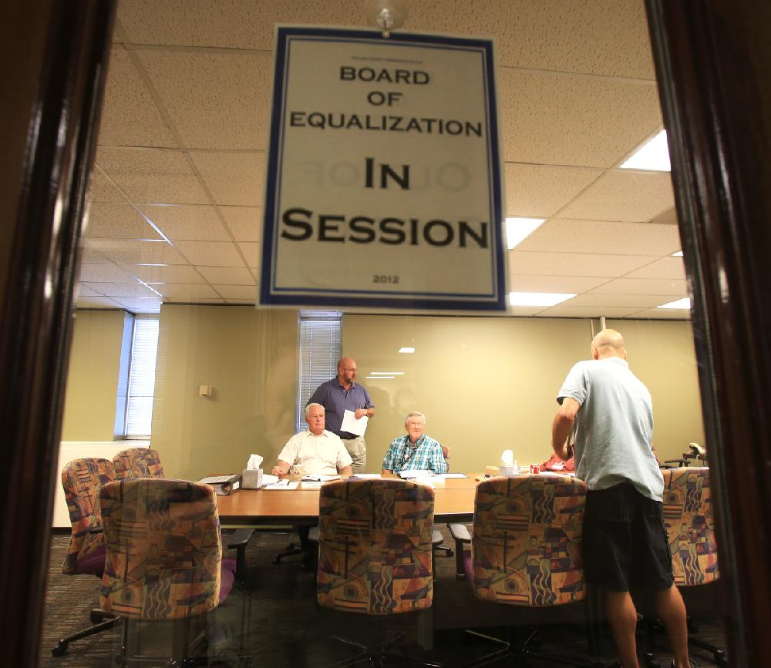
Hearing Tips

Slide 99
How the laws, delegated power, and due process influence your role
Constitutional separation of power – each branch has a role to play
Statutes – provide for the type of issues the BOE can resolve
Due process – requires the opportunity to be heard by a fair tribunal

Slide 100
Before the Hearing
Review the file if possible
Review the laws/rules if necessary
Make notes about issues/questions
OK to discuss (mind the OPMA), but don’t pre-judge

Slide 101
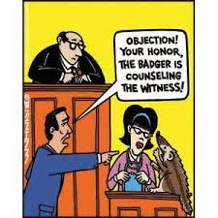
During the Hearing
Due Process: ensure an orderly proceeding that is fair
Allow enough time
Be flexible whenever you can
Expect the unexpected issue
Manage the hearing
Get enough facts to decide the issue

Slide 102
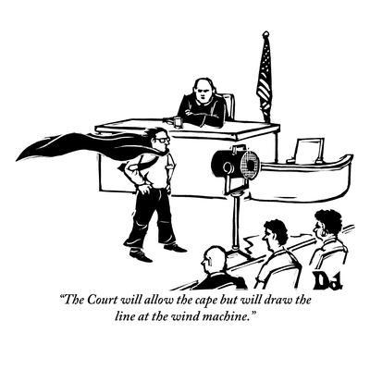
As the Hearing continues
Due process – allow parties the opportunity to be heard
Allow the appellant to express their case, but not to vent to excess;
Minimize exchanges between the parties, remind them to address & convince you (i.e., please address the board);
Make sure each party has made their best points;
Disclose any personal knowledge that you use;
Use appropriate body language.

Slide 103
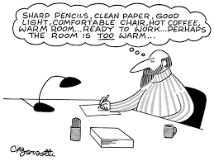
After the Hearing:
If more information is needed, call both parties back into the hearing (burden of proof remains on the taxpayer). See WAC 458-14-160(1) (extensions of time).
Put your notes in order as soon as possible after the hearing so that you don’t forget what you’ve heard.
Write a board order that explains the decision and how it was made. See also WAC 458-14-116 (form of the order).

Slide 104
Laws and Rules

Slide 105
Different types of law
Type of Law | Authority | Description | Relevant Examples
Constitutional Law | “The people” | Defines and/or limits government’s power with respect to people. | “Due Process” Clauses “Uniformity” Clause in Article VII, §§ 1 & 9.
Statutory Law | Legislatures (state and federal) | Sets forth the laws of the State or country | Revised Code of Washington (RCW) Title 84 26 U.S.C. Ch. 1 (Federal Income Taxes)
Administrative Law | State and federal agencies | Legislature creates “agencies” to execute specific governmental functions as subject matter experts. They are granted quasi-legislative and quasi-judicial powers within specific standards. | Washington Administrative Code (WAC) WAC Title 458 (Department of Revenue); WAC Title 456 (Board of Tax Appeals).
Municipal or Local Law | Governing bodies of municipalities/districts | Laws limited to particular district and local governmental functions. | Ordinances and Resolutions.
Common Law | Judges interpret the law and apply laws to facts to decide cases | Decisions are made on the basis of preceding rulings by judges (precedent) | Washington Supreme Court decisions: Weyerhaeuser Co. v. Easter, 126 Wn.2d 370, 894 P.2d 1290 (1995). Published Court of Appeals decisions: University Village Ltd. Partners v. King County, 106 Wn. App. 321, 23 P.3d 1090 (2001).

Slide 106
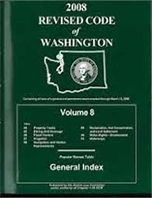
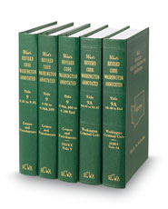
Statutory Law - Washington Statutes
The RCW (Revised Code of Washington) codifies laws enacted by the state legislature. It is arranged by:
Title
Chapter
Section
For example: RCW 82.48.010
Title 84 contains Property Tax laws
Chapter 48 contains Equalization of Assessments
Section 010 contains the law about forming BOEs

Slide 107
Relevant statutes for BOEs:
Chapter 84.48 RCW “Equalization of assessments” discusses county BOEs
RCW 84.48.010 – formation, meetings, duties, what claims are reviewed, timelines
RCW 84.48.014 – composition, appointment, qualifications
RCW 84.48.042 – training school ☺
RCW 84.48.200 – rules to be enacted by the Department of Revenue
What laws are you applying to the cases before you?
RCW 84.40.038 – petitioning the BOE
Chapter 84.36 RCW – property tax exemptions
Chapter 84.37 RCW – property tax deferral programs
Chapters 84.33 and 84.34 RCW – timberlands and open space, current use
Chapter 84.70 RCW – destroyed property

Slide 108
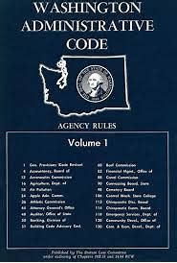
Administrative Law – Washington Rules
The WAC (Washington Administrative Code) are the rules written by administrative agencies and adopted through a public hearing process. They often interpret and explain statutes.
Like the RCWs, the WACs are broken down by
Title
Chapter
Section
For example, WAC 458-14-001
Title 458 - Department of Revenue Rules
Chapter 14 - Boards of Equalization
Section 001 – Introduction

Slide 109
Relevant WACs for BOE
Chapter 458-14 WAC governs county boards of equalization
WAC 458-14-015: jurisdiction of county BOEs
This WAC lists the types of appeals you are authorized to hear
WAC 458-14-056 through -171
Lists the rules of practice and procedure before BOEs including the following
Sets forth time limits for filing of petitions; potential waiver of deadlines
Explains how to “exchange information” between parties
Provides information on hearings before BOEs, notices, testifying, record of hearing
Explains how BOE issues orders and notices of value adjustments

Slide 110
Common Law, or Case Law
Only published opinions of the Washington State appellate courts are “controlling” or “precedential” (Supreme Court, Court of Appeals).
Other judicial or administrative decisions are not controlling, but may be persuasive.
Your prior decisions
Superior court decisions
Board of Tax Appeals decisions
Attorney General Opinions
Judicial or administrative decisions from other state tribunals
Judicial or administrative decisions from federal tribunals
Note that no federal issues should ever be before you. If you are trying to evaluate an issue of federal law, you have wandered out of your jurisdiction

Slide 111
To “cite” a case:
Weyerhaeuser Co. v. Easter, 126 Wn.2d 370, 894 P.2d 1290 (1995)
Weyerhaeuser Co. v. Easter, 126 Wn.2d 370, 894 P.2d 1290 (1995)
Year of Publication
Case name
Names of the parties – can be abbreviated
Plaintiff (appellant, petitioner, etc.) first
Defendant second
Always italicized
Washington Reporter identification
Volume number
Series (Wash, Wn.2d, Wn.3d)
Initial Page Number
Regional Reporter
Volume number
Series (P, P.2d, P.3d)
Initial Page Number

Slide 112
Constitutional Law
Remember that Constitutional questions are not within your authority. But there are two important constitutional principles to keep in mind:
1. Due Process (“notice and opportunity to be heard” before deprivation)
Notice of the government action
Opportunity to know the reasons
The opportunity to appear and present evidence
Reasonable time to prepare one’s case
An orderly proceeding with the ability to cross examine witnesses and present rebuttal evidence
An impartial, qualified tribunal
A reasoned decision (not arbitrary/capricious)

Slide 113
Constitutional Law
2. Uniformity of Taxes
The Washington Constitution requires “Uniformity”
Uniform tax rate (all real property in the jurisdiction shall be taxed by that jurisdiction at the same rate).
Uniformity in assessed valuation (all property shall be assessed at the same percentage of its market value).
What does that mean for you?
Equalization = The process for ensuring uniformity
Uniformity = All properties at market value

Slide 114
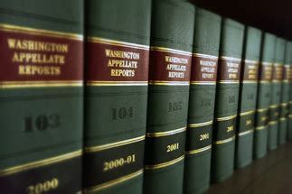
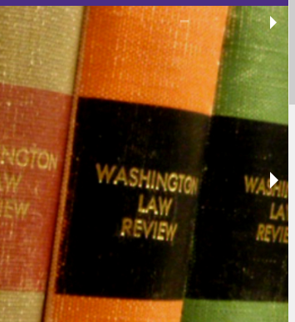
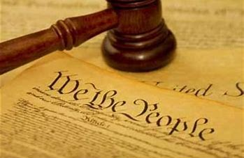
Weight to Give Legal Resources
Legally persuasive (helpful, but does not control the outcome of a different case)
Legal Authority (binding on all citizens, unless authority changes it)
Superior Court opinions; and,
unpublished appellate court opinions.
Attorney General Opinions
Law review articles, law dictionary, legal practice guides, desk books.
Supreme Court and published appellate court opinions
(AGO 1986 No. 3 - Feb 18 1986)
(Wn.2d, Wash., Wn. App.2d, Wn. App.)
Agency Regulations
(WAC 458-14-046)
State Statutes
Board of Tax Appeal Decisions
(RCW 84.48.042)
Department formal actions: interpretation letters, directives and Property Tax Advisories (PTAs)
Federal and State Constitutions
Department informal actions: manuals, webpages, trainings, etc.

Slide 115
When to use legal authority
When you issue your decision, think about which legal authority is relevant:
Statutes: always cite the statutes that apply to your case and apply the facts before you to the statute
WACs: if possible/applicable, cite a rule that applies to your case; rules provide greater explanation of how the statutes apply to particular circumstances.
Case law: cite for burden of proof and to support your decision, if relevant
When the court addresses how the statute and/or WAC at issue in your case applies to a situation, and your case arises from the same or very similar situation, your decision should result in the same outcome
When the facts in the case are meaningfully different than the facts before you, you can decide your case differently – the case does not control
When the case involves similar facts but the court does not address the statute or rule at issue in your case, you can decide your case differently - the case does not control

Slide 116
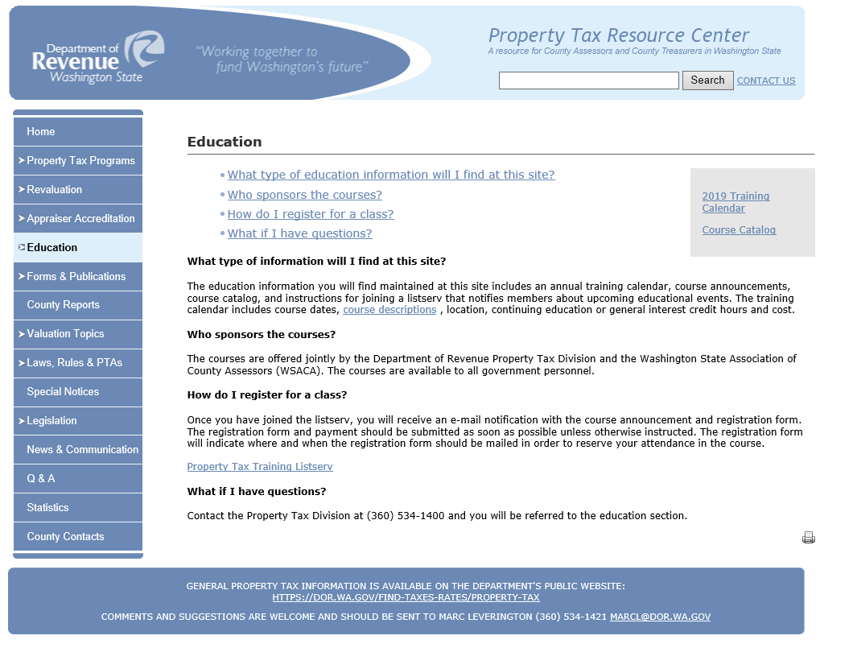
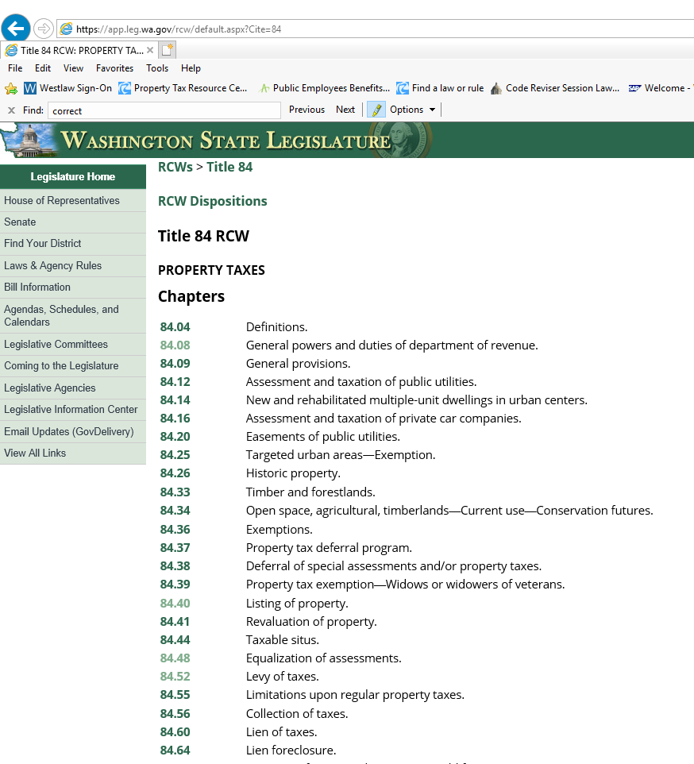
Where to find Legal Resources
Property Tax Resource Center - http://propertytax.dor.wa.gov/
Access to guidance documents, manuals and specific topic information
Catalog of links to Property Tax specific RCWs and WACs.
Office of the Code Reviser - http://leg.wa.gov/CodeReviser
Official and latest update of Revised Code of Washington (RCW)
Official and latest update of Washington Administrative Code (WAC)
Links to laws and rulemaking which changed RCWs and WACs

Slide 117
Where else to find Legal Resources
Published Court Cases, Law Review Articles, Practice Guides, etc.
Law Library (Courthouses or some local libraries)
Office of Reporter of Decisions: http://www.courts.wa.gov/appellate_trial_courts/supreme/?fa=atc_supreme.reporter
Internet (some cites are free: FindLaw or Justia; others require subscription: Westlaw or LexisNexus)
County Prosecuting Attorney may be able to help
Attorney General Opinions:
https://www.atg.wa.gov/ago-opinions
Board of Tax Appeal Decisions
https://bta.wa.gov/index.php/decisions-3/

Slide 118
Wrap-up & Evaluations
Thank you for your participation today. Let us know how we did by completing this survey by June 11.
Please let me know if you have suggestions OR complaints.
If you indicated you wanted a certificate of attendance during registration, we will send yours within a few days. Or you may email dorpropertytaxeducation@dor.wa.gov to make a request.
Training Season:
Basic BOE: Online in future since, only 1 registrant for the in-person class
Senior BOE: Online, topics and questions were due with registrations. Did not get much.
June 5: Full
June 24: Full
June 26: Open
Board of Equalization Training – New Members & Clerks

Slide 119
Contact Us
Website
https://propertytax.dor.wa.gov/
Phone Number
360-534-1400
For any questions or to get help from our experts
Email
rikkib@dor.wa.gov
dianabu@dor.wa.gov

