Slide 1
Board of Equalization Training
2025 – New Members & Clerks
Presented by Rikki Bland et all
June 3-4, 2025

Slide 2
Agenda & Attendance
Board of Equalization New Member Training - 2025

Slide 3
2025 Board of Equalization Training
Real Property Valuation
Presented by Marilyn O’Connell

Slide 4
Property tax is an “ad valorum” tax meaning it is based on the value of the property. It is mostly administered by local government.
Notes:
Property Tax is based on the value of property – in some states it’s calculated as a percentage and in some states, it’s based on 100% of market value. And as you all know, it is administered by each county in the State of Washington.
DOR has oversight of the Assessor’s office, so we don’t get involved in individual appraisals.

Slide 5
Basis of Valuation
Notes:
All property must be values at 100% of market value unless it is specifically exempted.
Market value money a willing will pay to a willing, non-obligated seller, both being knowledgeable of the market. Open market transaction
Assessors use sold property information and apply it to the non-sold properties.

Slide 6
Real Proper is defined in: RCW 84.04.090 WAC 458-12-010
Notes:
RCW? Laws created by the Legislature of the State of Washington
WAC? Rules governing how the state does business. Both are legally binding
All buildings, structures or improvements or other fixtures.
All standing timber growing thereon.
Mobile homes that have lost their identity as a mobile unit by being permanently fixed in a location, placed on a permanent foundation with fixed pipe connections to water, sewer, or other utilities.

Slide 7
Valuation vs. Property Tax
Notes:
Assessed value is used in the calculation of property tax, but it does not directly determine the amount of property taxes paid.
Property taxes are administered by local government.
The assessed value is determined by the assessor before property tax levies are calculated.

Slide 8
Each county assessor shall maintain an active and systematic program of revaluation of all taxable property on a continuous basis:
Revaluation of all taxable real property each year.
Physical inspection at least once every six years.
Revaluation Requirements
RCW 84.41.030
Notes:
Each county must have a schedule for inspection and valuation of all property in their county each year:
All parcels must be inspected at least once every six years. Most counties inspect every six years. Three counties inspect every 4 years: Chelan, Ferry, and San Juan.
All parcels must be reappraised or revalued each year.
The assessor must file their plan with the DOR the year prior to the first year of their Revaluation Plan.

Slide 9
Revaluation Plans
Department of Revenue must approve prior to the first year of any revaluation and physical inspection cycle. (WAC 458-07-025)
Plan & Assessment Objectives:
Uniformity in taxation
Standard of market value
Active and systematic program of revaluation on a continuous basis.
Efficient use of limited resources
Notes:
A Revaluation Plan includes:
What parcels are inspected in each inspection year
How many appraisers are available to do inspections
How many days you expect to be in the field for those inspections
How many inspections on average can an appraiser do every day
How are you doing your valuation work
Are there current challenges to getting your work done?

Slide 10
Transition to Annual Revaluation
Revaluation area is the whole county
Notes:
REVALUATION AREA = ENTIRE COUNTY EVERY YEAR

Slide 11
Physical Inspection Areas
Notes:
Example: Snohomish County

Slide 12
Changes with Annual Valuation
Inspection at least once every 6 years
Values statistically updated each year
Expanded use of Mass Appraisal Practices
More reliance on statistical modeling

Slide 13
Advantages of Annual Valuation
Promotes uniformity.
More predictable values for property owners.
Stabilize sharp spikes in values.
Expand inspection interval to 4 or 6 years.
Reflect current market considerations for industries or market areas that are in the midst of sudden change.
Improves level of assessment as measured by the ratio of assessed value to market value.

Slide 14
Advantages of Annual Valuation
Current values for taxing districts - more reflective of the property and users of the services provided.
Closer alignment with personal property cycle - promotes uniformity between classes of property.
Simplification of administrative rules and processes.

Slide 15
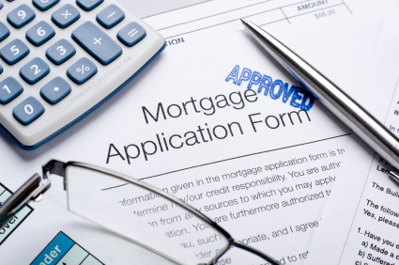
Fee Appraisal
vs
Mass Appraisal
Notes:
One thing to remember: Assessors are not predicting future value. They are valuing property based on the January 1st lien date.
Fee appraisals are valuing the property as of the date of the appraisal

Slide 16
Mass Appraisal
Notes:
Mass appraisal is an estimate of value for many properties using standard procedures and statistical testing.

Slide 17
Objectives Do Not Change
Notes:
Both fee appraisal and single property appraisal are trying to determine market value.
When doing mass appraisal, the requirements are the same as doing an individual appraisal.
USPAP and IAAO
Appraisal objectives when performing mass appraisal:
Uniformity in taxation
100% market value
Revaluation on a continuous systematic schedule
And mass appraisal provides a means to efficiently use limited resources

Slide 18
Sales Validation and Verification
Notes:
It is extremely important to validate and verify all sales as soon as possible after the sale. It’s these sales that the assessor uses to set the values in their models and to adjust values from year to year.
Validation is determining whether a sale is an open market transaction

Slide 19
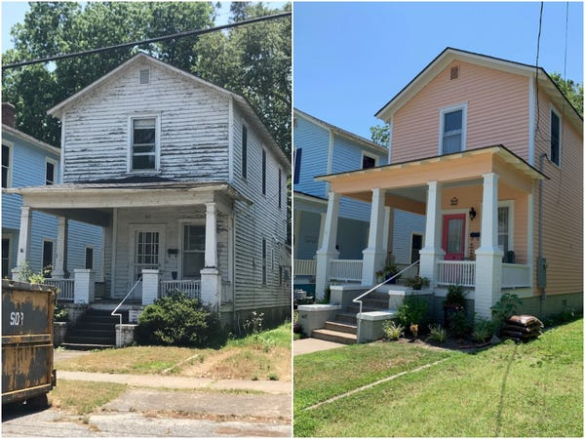
Verification of Sales
Notes:
Verifying a sale: confirming and updating the characteristics of a property when sold to ensure accurate data for the parcel.

Slide 20
Three Approaches to Value
Cost Approach
Income Approach
Market Approach (Sales Comparison)
Notes:
Appraisers must consider all three approaches to value.
But some approaches just make more sense for certain types of property.

Slide 21
Based on Principle of Substitution
Cost doesn’t always equal value - but can be a valid determinant of value
The cost approach can be applied to most classes of property
Requires analysis of characteristics: Design, Construction Type, Quality, Square Footage, Age, etc.
The Cost Approach to Value
Notes:
Principle of Substitution assumes a buyer wouldn’t pay more for a property than it would cost to build an equivalent property.

Slide 22
Reproduction Cost
Two Ways to Calculate
vs.
Replacement Cost
Notes:
So, Reproduction Cost and Replacement cost are the 2 common ways to determine the cost valuation.

Slide 23
Reproduction Cost
Cost to construct a duplicate building
Using identical construction and materials
Notes:
Reproduction cost looks at the cost of creating an exact replica.

Slide 24
Replacement Cost
Cost to construct a building with same utility
Current prices, standards, & material
Typically used by Assessors
Use square foot method to calculate cost (Marshall and Swift)
Notes:
Replacement cost is the estimated cost to build a new building that has the same utility using modern materials and designs

Slide 25
Replacement Cost New Less Depreciation (RCNLD) Indicates
Improvement Value
Notes:
So, we get a replacement cost and then we need to apply depreciation to get our total improvement value. If we had a new structure, there wouldn’t be any depreciation
In Appraisal:
Process of measuring the loss in value of an asset or group of assets.

Slide 26
Depreciation
Physical Deterioration
Results from wear & tear, use & abuse, inadequate repair, etc.
Notes:
Physical depreciation results from wear and tear, abuse, or not doing needed repairs.
In order to figure out depreciation you need know what the economic life of the item is

Slide 27
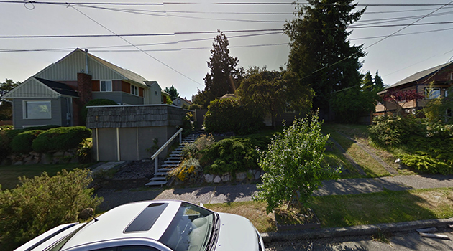
Depreciation
Functional Obsolescence
Results from poor layout or design, under/over improvement, change in tastes, nonconforming style.
Notes:
This type of depreciation is due to a bad home design or layout

Slide 28
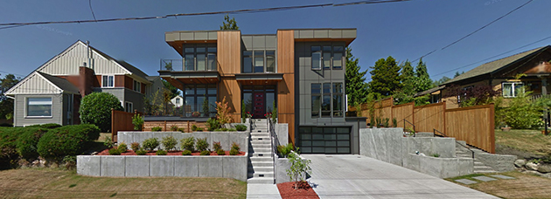
3,640 square feet, assessed at $1,396,000
Source: Google Street View

Slide 29
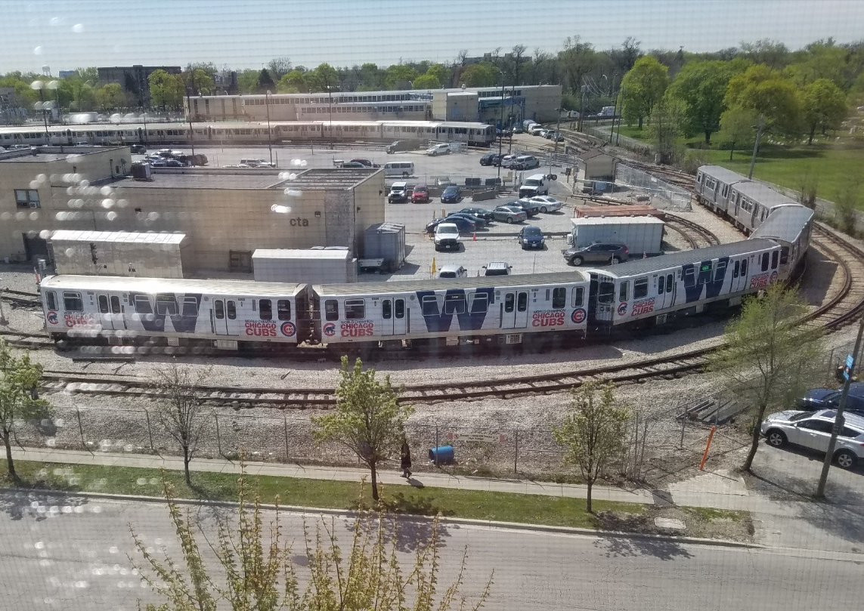
Depreciation
Economic Obsolescence
(AKA External Obsolescence)
Results from forces outside of the property, i.e. heavy traffic, excessive noise, unpleasant odors, physical hazards, etc.
Notes:
Economic Obsolescence is caused when there is an exterior influence that can affect the value of a property

Slide 30
Example RCNLD
RCN (replacement cost new) $150,000
Less Depreciation $ 50,000
RCNLD (Improvement Value) $100,000
Plus Land Value $ 40,000
Total Property Value $140,000
(or Market Value)

Slide 31
Advantages:
Universal application
Sometimes the only approach for special
purpose properties
Well adapted and easily applied
under a mass appraisal system
Disadvantages:
Difficulty in estimating depreciation
especially in older structures
The Cost Approach to Value

Slide 32
Based on Principle of Anticipation
Value equals the present worth of future benefits that come from ownership
The benefits are the future income stream the property will generate
Must consider the quantity, quality, & duration of potential income stream
The Income Approach To Value

Slide 33
Income and Expense Data Needed for the subject and the market
Unit of Comparison (Rent)
per sq. ft.
per unit - storage, rental, hotel
per bin - grain
Vacancy and Collection Loss (from Market)
Expenses (Subject and from Market)
Fixed and Variable Expenses
Typical for property type; replacement reserves, utilities, property management, insurance
Cap rate
Data Needed for Income Approach

Slide 34
Recapture Rate
(Return of your investment)
Usually 1/Life Expectancy
Example: 1/50 years = 2.0%
Discount Rate
(Required rate of return on your investment) 5.0%
Effective Tax Rate
(For use in ad valorem valuation) 1.5%
Capitalization Rate (sum of components) 8.5%
Components of a Capitalization Rate
Notes:
The cap rate estimates the investors potential return.

Slide 35
Income = R x V
Rate = I ÷ V
Value = I ÷ R
The “IRV” Equation
Divide
I
Multiply
R
V
Notes:
So, if you have any two pieces of information you can calculate the third. What assessors are trying to determine is the value of a piece of property, so they would take the income divided by the rate to get the value.

Slide 36
Advantages:
Generally, the most reliable for commercial / income producing properties
Market data available from investors who buy & sell on the basis of a property’s income capabilities
Disadvantages:
Limited use for valuation of residential properties or some types of special use properties
Limited income data available to Assessors
The Income Approach to Value

Slide 37
The Sales Comparison Approach To Value
Based on principles of Substitution & Contribution
Value tends to be set by the cost of acquiring a substitute property
Generally, reflects market behavior
Notes:
Many assessors use the market adjusted cost approach, so they determine a cost valuation and then analyze the applicable sales to determine a final value.

Slide 38
Data Needed
Subject characteristics
Design, Construction Type, Quality, Square Footage, Age, Location, etc.
Comparable sales data & characteristics
Valid Sales – Compares sold properties to the subject property
Uses properties with similar characteristics, location, recent, arm’s length transaction
Data Needed for Sales Comparison Approach

Slide 39
Sales Comparison Approach to Value
Advantages:
Widely recognized as a reliable valuation approach by nearly all involved with real property values including taxpayers, courts, salespersons, lenders, fee appraisers, and assessors.
Processed directly from market actions of buyers and sellers
Easily understood
Notes:
Sales comparison approach is easily understood – usually taxpayers that file appeals talk about comparable sales
Most people have had an appraisal done and understand that comparable sales are used.

Slide 40
Sales Comparison Approach to Value
Disadvantages:
Instances when sufficient sales
data is unavailable
Difficult when subject property
is unique

Slide 41
If the appraisal dates differ, remember that the further from the assessment date the less reliable the appraisal.Lien date for assessment is January 1st
Review market information and also info. provided by taxpayer and assessor – trends
What approach to value was used?
What adjustments are made to subject?
What is the purpose of appraisal?
Is it reasonable?
Does it have info about the property the assessor did not know?
Comparing Residential Appraisals
Notes:
Four major types of adjustments: time, location, physical condition, and the contribution of components

Slide 42
Mass Appraisal
Single Property Appraisal
Mass Appraisal
An estimate of value for a single property or ownership
An estimate of values for many properties using standard procedures and statistical testing. (IAAO)
Notes:
Assessors use market data to estimate the value of many properties using the valid sales. It is not practical or feasible to do individual appraisals for thousands of parcels annually.

Slide 43
A model is a representa-tion of how something works.
Supply
Demand
Notes:
Supply and demand drives the real estate market and what someone will pay for real estate.

Slide 44
Mass Appraisal was developed to meet the need for greater uniformity and consistency in assessments.
Mass appraisal has an increased emphasis on:
Standardized procedures
Valuation models
Testing
Successful implementation requires:
Trained Staff
Technology – Hardware, Software, GIS
Mass Appraisal
Notes:
Mass appraisal is applying valuation models to hundreds or thousands of properties and tests those models by doing a statistical analysis.

Slide 45
Steps in Mass Appraisal
Identify market areas
Develop methodology to achieve accurate and consistent data
Validate and verify sales
Specify mathematical models based on market data for properties that are similar
Calibrate models annually or as needed
Test models by running statistical tests
Report current market data to stakeholders

Slide 46
Mass Appraisal Process
Determine how much value the characteristics add to the value
Test model, do quality control, and reconcile of values
Create reports of work
Handle appeals
Collect market data
Analyze market data
Consider highest & best use
Determine what characteristics should be in the valuation model

Slide 47
Single Property Appraisal skills are still necessary in the Mass Appraisal environment.
Mass Appraisal models are an expansion of single property fundamentals
Necessary for special purpose and unique properties
Used to defend values for appeal purposes
Mass Appraisal
Notes:
Typically, appraisers use mass appraisal to value property, but for the BOE, they will talk about the relevant sales, because that is what the taxpayer is going to address.

Slide 48
Improvement Value Equals:
Base value
x (size factor)
x (construction quality)
x (condition factor)
x (building style factor)
x (influence factor)
Notes:
About 95% of value of an improvement comes from about 4 things: size, quality, condition, location

Slide 49
Example of a Land Model
Land Value Equals:
Base Value
x (size factor)
x (location factor)
x (traffic factor)
x (utility factor)
x (influence factor)
Notes:
Again, land value can be derived from just a few characteristics:
Location, location, location
Size
View
Waterfront

Slide 50
Total Value
Improvement Value + Land Value = Total Value
$168,000 Improvement + $43,750 Land =
$211,750 Total Property Value
Notes:
So, the assessor is required to determine both a land value and an improvement value to determine the total assessed value. In an appeal, you want to look at the total value of the parcel and whether that is reasonable.

Slide 51
Market Adjustments
One method used to statistically update values is using a market adjustment factor derived from the AS ratio of assessed value to market value (sales price). Sometimes this is referred to as trending the previous value to the current market value.
Example: Sales over the past year indicate assessed values need to ber increase by 5% to reflect the new true and fair value
All Properties would have a market adjustment factor of 1.05 applied to reflect this value increase
Previous AV x Market Adjustment Factor = New AV

Slide 52
Time Adjustments
Can be done by graphing AS ratios in Excel (using sales)
AS or AV ratio - the ratio of Assessed Value/ Sales Price
A county can use up to five years of sales in order to have enough sales for a valid analysis
This adjustment can be done county wide, by property characteristic, or location

Slide 53
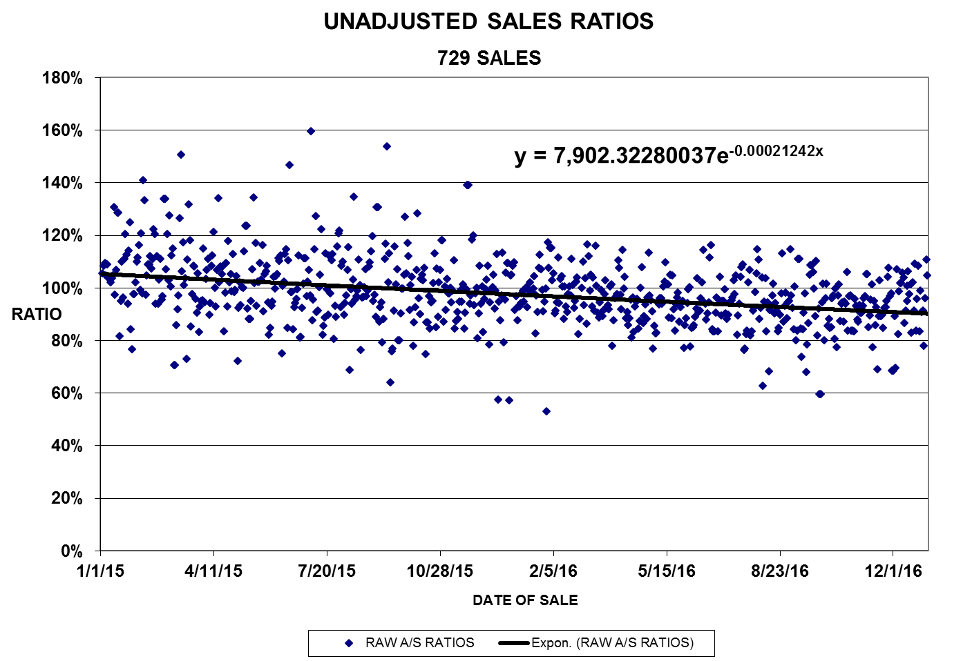
Statistical Updates
Notes:
The assessor can graph the sales to determine how much the market has changes over a certain time frame and adjust the sales accordingly.
Current AV x Market Factor = New Assessed Value

Slide 54
Mass Appraisal Report Uses
Document the appraisal process
Communicate the mass appraisal process and results to taxpayers and BOE members
Defend values at appeal
Conduct training classes
Provide sales data and neighborhood or valuation area reports to taxpayers or other interested parties through posting on the county website

Slide 55
Reports in the Appeal Process
Some counties will continue to provide the BOE with comparable sales in a grid format that are adjusted specifically for the property under appeal.
Many counties will provide the BOE with a mass appraisal report for the “valuation area” or “neighborhood” of the subject property.
Notes:
Mass appraisal report Information may include:
Property records
Sales ratios & other statistical studies – sales used
Appraisal manuals or other documentation
Market studies – change in value
Model building documentation

Slide 56
Reliability of Mass Appraisal Reports
The reliability of any appraisal is dependent on good data and good judgment.
In most cases a mass appraisal report will explain and support the value of the property.
Sometimes, even the best mass appraisal models may result in individual value conclusions that will not meet standards of reasonableness, consistency, and accuracy. In these instances…
The property owner should first contact the assessor and request a review of both the property record and appraisal information. If not satisfied with the review, the owner may appeal to the BOE.

Slide 57
Destroyed Property
The assessed value of property may be reduced if:
By Dec. 31st, property is destroyed in whole or in part; or
The property has been reduced in value by more than 20% and is in an area declared a disaster by the Governor or the CLA
RCW 84.70.010

Slide 58
Destroyed Property
Refund or Abatement of Taxes:
Taxes may be abated or refunded during the tax year in which the destruction occurs unless the property was damaged or destroyed voluntarily.
The amount of relief is determined by the value of the destroyed property and the date of destruction.

Slide 59
Destroyed Property
New Construction:
If destroyed property is replaced prior to July 31, the county assessor will place the additional value on the assessment roll for that year.
If the taxpayer disagrees with the value after the improvement has been removed or after subsequent new construction is added, they can file an appeal with the BOE.

Slide 60
Questions?
Contact:
Marilyn O’Connell
marilyno@dor.wa.gov
360.534.1364

Slide 61
Reconvene Requests
Notes:
Reconvened Boards are limited to 3 years after the last day of their regular convened session (RCW 84.08.060 & WAC 458-14-127).
Except in the case of omitted property or value.
****While a petition might be helpful to the board & assessor, none is required.****
Checklist for complete requests:
Code 1:
Has the taxpayer provided an affidavit? Did the taxpayer show the value changed from the prior year?
Code 2:
Has the assessor provided an affidavit? May not be processed if the assessor is not requesting.
Code 3:
Did the property sell/transfer after July 1 for less than 90% of the assessed value? Was it an arm’s-length transaction?
Timeliness:
Was the request filed by April 30 of the year following the assessment year?
If the Board determines the request does not meet all the requirements, they must:
Issue a written denial to the taxpayer and assessor,
Inform the taxpayer of appeal rights.
Denials of reconvening requests may be appealed to the State Board of Tax Appeals.
The appeal must be filed within 30 days from the date of mailing.

Slide 62
Authority
The Department
Boards of Equalization
General Requirements and Limits
..may require any board to reconvene at any time for the purpose of performing or completing any duty or taking any action the board might lawfully have performed or taken at any of its previous meetings, or for any other purpose allowed by law.
…may reconvene on their own authority to hear requests concerning the current assessment year.
All requests must:
Specify the assessment year(s).
State the specific grounds for the request.
Taxpayers must confirm:
They are the owner, a duly authorized agent, personal representative, guardian, or a lessee responsible for paying property taxes.
Reserved for:
Situations where an error has occurred.
Circumstances where regular appeal procedures do not apply.

Slide 63
Taxpayer initiated Request (due by April 30th)
Code 1
Taxpayer must submit a sworn affidavit stating:
They did not receive notice of a change in value.
If notice was received, must have been received fewer than 15 calendar days before the petition deadline.
Taxpayer must provide evidence that the property's value was changed.
Could be the roll history online or the prior and current value on the NOV.
Note: Timely notification is essential to allow fair opportunity for appeal.
Notes:
Taxpayer Request: A taxpayer submits an affidavit stating that they did not receive notice of a change in value at least fifteen calendar days before the deadline for filing a petition and can show proof that the value was actually changed.
Due April 30th of the year following the AY requested.

Slide 64
Assessor initiated request (due by April 30th)
Code 2
Assessor must submit a sworn affidavit.
Must state they were unaware of discoverable facts at the time of appraisal.
Must show that the lack of knowledge materially affected the property valuation.
The request must be filed by April 30 of the tax year immediately following the board’s regular convened session for the requested assessment year.
Note: Ensures assessed values reflect accurate, available information.
Notes:
Assessor's Request: An assessor submits an affidavit stating that they were unaware of facts that were discoverable at the time of appraisal and that such lack of facts caused the valuation of property to be materially affected.

Slide 65
Taxpayer initiated request (due by April 30th)
Code 3
Taxpayer or purchaser acquires property after July 1 and before December 31 of the assessment year being requested.
The transaction must be at arm’s length (fair market conditions).
Taxpayer must demonstrate this with the request.
The sale price is less than 90% of the assessed value.
Must provide evidence of the original assessed value and the sale price.
Note: This allows an appeal when assessed values significantly exceed actual sale prices under market conditions.
Notes:
Arm's Length Transaction: A bona fide purchaser or contract buyer acquires an interest in real property after July 1 and on or before December 31 of the assessment year, and the sale price was less than ninety percent of the assessed value.

Slide 66
Omitted Property or value (due within 30 days of notice)
Code 4
Assessor or Taxpayer may request a reconvene for property or value omitted from the assessment roll.
Applies when: Omitted property or value is added to the assessment roll.
Requests cannot be accepted for assessment years more than three years prior to the year the omission was discovered.
Generally identified through physical inspection (e.g., home addition not previously assessed).
Omitted value may be added to the current year and up to three prior years.
Notes:
For example, the current assessment year would be 2025 and the three prior years would be for the 2024, 2023, and 2022 assessment years.
The assessor must send the taxpayer a NOV for all assessment years in which the value was added to the roll.
The taxpayer can appeal any or all of these assessment years to the BOE within 30/60 days of the NOV date.

Slide 67
Intervening year request (due within 30 of BOE order on prior year)
Code 5
The Assessor or taxpayer may request the BOE reconvene if all of the following apply:
Real property is revalued annually.
A timely appeal was filed for a prior year (e.g., 2021).
No appeal was filed for the intervening year (e.g., 2022), and the assessed value did not change.
The reconvene request is filed within 30 days of the BOE’s decision for the earlier appeal.
Example
Taxpayer appealed their 2023 value. In 2024, the value didn’t change, so they didn’t appeal. Once they receive the 2023 BOE decision, they realize they want to appeal 2024.

Slide 68
Code 6 (limited to 3 years)
Equalization outside the regular convened session or for prior year appeals
Requests may come from the Board or the Assessor and must be submitted to the clerk.
Processed the same as local requests.
Include valuation information or other documentation supporting equalization request.
Identify all impacted parcels and assessment years.
If granted, Board does not hold a hearing and independently determines if values should be adjusted through equalization and issues orders for any impacted parcels.
Denials may be appealed to the BTA.
Notes:
Requests for reconvening may come from either the Board of Equalization or the Assessor and must be submitted to the board clerk.
The clerk processes Department of Revenue (DOR) reconvene requests the same as local requests by:
Verifying the request is complete. If no evidence is included, the clerk should contact the taxpayer to see if evidence will be submitted before sending it to DOR.
Once the request is complete:
Assigning a request number
Forwarding a copy to the Assessor’s office
Sending the request and any Assessor response to the Department of Revenue
The DOR will issue a decision to approve or deny the request.
If approved, the board is directed to hold a hearing for the specified assessment year(s).
If denied, the taxpayer or Assessor may appeal the decision directly to the Board of Tax Appeals (BTA).
The clerk will process DOR reconvene requests the same as local requests:
Verify the request is complete (if no evidence is included, reach out to see if the taxpayer intends to submit any BEFORE sending it to DOR)
Once a completed request is received:
Assign a number to the request
Forward a copy to the assessor’s office
Forward the request and assessor’s response (if any to the Department of Revenue)
DOR will issue a decision indicating whether the request is approved or denied.
If approved, the board is directed to hold a hearing for the assessment year(s) specified.
If denied, the parties may appeal directly to the BTA (taxpayer or Assessor).

Slide 69
Code 7 (limited to 3 years)
Prima facie case of 100% overvaluation or fraud
The Department’s preferred criteria for determining overvaluation are:
Market value determinations from orders of the BOE, or the State Board of Tax Appeals (BTA);
Signed stipulations between taxpayers and assessors;
Market-based evidence of market value, i.e., an arms length transaction with a market value appraisal of the subject property.
Clerks should verify all supporting documentation is provided at the time of request.
This is not a valuation appeal but does require evidence of valuation to support the overvaluation claim.

Slide 70
Good Cause Waiver of Filing Deadline
Notes:
A petition filed after the regular deadline to the Board is unable to be accepted unless the taxpayer can demonstrate good cause for the late filing.
If a petition is submitted late without any initial explanation, the board is required to dismiss it. However, the taxpayer must be notified that their petition will be dismissed due to untimeliness, and that they may still be granted an opportunity to promptly provide documentation showing good cause for the delay.
Procedural fairness is a cornerstone of the property tax appeal system, and strict adherence to filing deadlines plays a critical role in ensuring that fairness. Every taxpayer is given the same opportunity and timeline to appeal their property valuation, and the majority comply with these deadlines. Allowing late petitions without clear, narrowly defined standards would undermine that fairness and could be perceived as granting preferential treatment.

Slide 71
Objective:
Allows Boards to accept late-filed petitions under specific defined circumstances.
Scope is Limited:
The Board may not expand the reasons for late filing beyond those outlined in statute and WAC.
Discretionary:
All good cause waiver reasons are optional for the BOE to grant — except one:
If no Change of Value Notice was sent and no change in value occurred, the Board must grant the waiver and accept the petition if filed within a “reasonable” time.
The Board’s decision:
Is made without a public hearing.
Must be communicated to the taxpayer in writing.
Cannot be appealed to the State Board of Tax Appeals.
Documentation Required:
The taxpayer must provide supporting evidence of the claimed good cause for a late filed petition.
Key Information
Notes:
The petition filing deadline exists to protect the integrity of the process and to provide certainty to the assessment and budgeting timelines that affect all taxing districts. It ensures that the appeal process is orderly, timely, and equitable for everyone — not just those who file late.
That’s why the law only permits late petitions in specific, limited circumstances that qualify as “good cause,” and why the Board may not expand these exceptions. Granting a waiver outside of what is legally allowed could be unfair to taxpayers who took the time and effort to meet the deadline, even in challenging situations.
By upholding the filing deadline and evaluating late requests solely within the bounds of law, the Board reinforces trust in the system and ensures that all taxpayers are treated equitably under the same rules.

Slide 72
What is required:
Evaluation of Requests
Timeliness: Petition must be filed within a “reasonable” time after the original deadline.
Waiver request deadline is set by policy, i.e. opportunity to perfect an untimely appeal.
Two weeks to a month are recommended.
Documentation or evidence supporting the claimed good cause should be provided prior to granting requests.
Board's Decision: Made without a hearing, majority vote of members; taxpayer is notified in writing.
Provide denial reasons when possible.
Finality: Board's decision is final and not appealable.
Denial of a waiver result in dismissal of the untimely petition.
All petition denials are appealable to the BTA.

Slide 73
Waiver Reasons
Death or Serious Illness
Taxpayer or immediate family member experiences death or serious illness near the filing deadline.
Documentation: Provides medical records or death certificate.
Absence from Residence
Taxpayer is absent from home for over 15 days before the filing deadline, and the notice was not received or forwarded by an agent.
Documentation: Proof of absence and agent's failure to forward notice.
WAC 458-14-056(3)
Incorrect Advice
Taxpayer relied on incorrect or misleading written advice from board staff, assessor, or the *property tax advisor.
Documentation: Provide copies of the incorrect information related to appeal filing or deadlines.

Slide 74
Waiver Reasons
Natural Disaster
Natural disaster (e.g., flood, earthquake) occurs near the filing deadline AND impacts the owner’s ability to file.
Documentation: News reports or official declarations of the disaster.
Postal Delay or Loss
Delay or loss in postal delivery of the petition (not the Notice of Value).
Documentation: Postal service documentation confirming delay or loss.
WAC 458-14-056(3)
Business Representative Unavailability
Business's responsible person is unavailable due to illness or unavoidable absence.
Documentation: Medical records or proof of absence.

Slide 75
The Only Mandatory Waiver!
No Change in Property Value
No change in property value from the previous year, and no change of value notice was sent.
Documentation: Assessment records and notice history either from the Assessor or county records.
It is important to know this does not apply in counties that send a Notice of Value to all taxpayers regardless of value change.

Slide 76
Equalization
Boards examine and compare assessments to see if comparable properties are comparably valued without an appeal.

Slide 77
Who and When
Prior to July 15th, the CLA must form a board for the equalization of the assessment of the property of the county.
Boards must meet in open session on July 15th or within 14 days of certification of the county assessment rolls; whichever is LATER.
Remain in session for 28 days
The assessor must certify the assessment roll to the board before the board can issue any valuation determinations for that assessment year.
Notes:
Member Qualifications and Requirements: WAC 458-14-035:
Members cannot be a holder of any elected office, but they can accept an appointed position to another board
Must reside within the county (snowbirds must be a residents of the state)
Board members must attend training within one year of their appointment or reappointment
Training may be waived by DOR for one year (Waivers are RARE – covid was an exception)
Persons who have been employed in the assessor's office shall not sit on that county's board for a period of two years after leaving their employment.
Serve a 3-year term or until successor is appointed
Clerks are responsible for tracking the expiration of a member's appointment and their training.
Regular Convened Session: RCW 84.48.010 & WAC 458-14-046:
The Department tracks this to ensure the board is meeting and adjourning timely.
Must meet at least 3 times during the 28-day session.
If the Board needs to extend session, they must request the CLA permit them to convene after the normal 28-day session to hear timely filed petitions.
(Notice of Approval to Hear Property Tax Appeals form (REV 64 0049))
What can you do during the meetings?
Swear in board members
Review the assessment roll
Hold hearings
Meet with assessor for generic discussion
Authorize members or the clerk to sign orders
Review BTA orders

Slide 78
Equalization Duties
Comparing Assessed Values
The Board reviews and compares property assessments in the county to ensure all property is assessed at its true and fair value, based on the valuation method used by the county assessor that year (presumed correct under RCW 84.40.0301). The board must take the following actions:
Increase undervalued real property:
Raise the value of any tract, lot, or item of real property assessed below its true and fair value.
Must give the owner or their agent at least five days’ written notice before making the change.
Decrease overvalued real property:
Lower the value of any real property assessed above its true and fair value.
Increase undervalued personal property:
Raise the value of any class of personal property or total personal property of an individual assessed below its true and fair value.
Requires at least five days’ written notice to the owner or agent.
Decrease overvalued personal property:
Reduce the value of any class of personal property or an individual’s total personal property assessed above its true and fair value.
Notes:
Equalization may be triggered when…
A pattern of appeals indicate there may be inequality within a group or class of properties.
An individual or group of taxpayers call or write about their assessed value as compared to similar properties.
The assessor may propose equalization to the board.
Any discrepancies or potential errors on the assessment roll (appeals of other properties may point to potential discrepancies).
The Board may investigate to determine if there are legitimate reasons for value differences between appealed and similar properties.
Orders (WAC 458-14-116):
Issued for all properties affected, clearly indicating the reasons for change in value.
Both parties have 30 days to appeal the order to either the BOE (again) or BTA.

Slide 79
Board Orders
Writing Clear and Effective Decisions

Slide 80
Purpose:
Well-Reasoned Decisions
To explain the outcome in a way that is understandable to both parties.
To provide a transparent and reasoned basis for the decision.
To ensure decisions are legally sound, factually supported, and administratively defensible.
To reinforce the neutrality and professionalism of the Board.
Ask Yourselves:
“Would someone unfamiliar with the case understand this?”
Notes:
Public Service Perspective
Remember that clarity builds public trust in the administrative process.
A well-written decision helps parties understand the outcome, even if they disagree with it.
Neutrality is shown not just by what is decided, but how it's explained.

Slide 81
Structure and Organization
What Does It Look Like?
Introduction
Identify the case type, parties, and issue(s).
Brief procedural history (hearing date, representation, etc.).
Findings of Fact
Clearly state the facts found credible.
Use numbered paragraphs for clarity.
Base facts on the record, citing evidence (e.g., exhibits, testimony).
Discussion/Analysis
Apply the relevant law to the facts.
Discuss conflicting evidence or interpretations.
Address any credibility decisions.
Conclusions of Law
Concisely state the legal conclusions drawn from the analysis.
Order
Clearly state the result and any action ordered.
Include effective date and appeal rights, if applicable.
Notes:
Clarity and Readability
Use plain language without sacrificing accuracy.
Avoid jargon unless necessary and define technical terms.
Keep sentences short and direct.
Use headings, bullet points, and formatting to break up complex material.
Demonstrate how the law applies to the facts in a logical and step-by-step manner.
Reference statutes, regulations, or precedent as appropriate.
Address key arguments raised by the parties, even if rejected.

Slide 82
“Justice must not only be done, but must also be seen to be done.” – Lord Hewart
Doing the Right Thing
Neutral Tone and Impartiality
Write in an objective tone.
Avoid emotionally charged or judgmental language.
Acknowledge arguments fairly, even when rejecting them.
Credibility and Evidence
Explain how credibility determinations were made (consistency, tied to evidence, etc.).
Cite specific evidence to support findings.
Distinguish between findings and conclusions.
Notes:
Anticipate Review or Appeals
Assume your decision will be read.
A well-reasoned, well-documented decision is the best defense against further action.
Ensure due process was followed and procedural issues are addressed.

Slide 83
Sales Comparison
Value tends to be set by the cost of acquiring a substitute property
Sales Price
+
Adjustments
–
Adjustments
=
Property Value
Notes:
Compares the sales prices of comparable properties and adjusts them to make them like the property being appealed.
Based on principles of Substitution & Contribution
Generally, reflects market behavior (data comes directly from market actions of buyers and sellers)
Principle of Substitution: The value of a property tends to be set by the price that would be paid to acquire a substitute of similar utility and desirability within a reasonable amount of time.
Principle of Contribution: The value of a particular component is measured in terms of its contribution to the value of the whole property. Inversely, the amount that it’s absence would detract from it.
Advantages:
Widely recognized as a reliable valuation approach
Processed directly from market actions of buyers and sellers
Disadvantages:
Instances when sufficient sales data is unavailable or subject property is unique

Slide 84
Comparability is greatest when both sales and subject are influenced by the same physical, economic, legal and social factors
Data Needed:
Subject characteristics
Design
Construction Type
Quality
Square Footage
Age
Characteristics and sales data for similar properties
Comparable Sales
Notes:
A comparable sale is a property similar to a subject:
Similar in physical, economic, or operating characteristics
Sales need to be recent and similar in use, utility & function
Sales need to be “Arms-length Transactions”

Slide 85
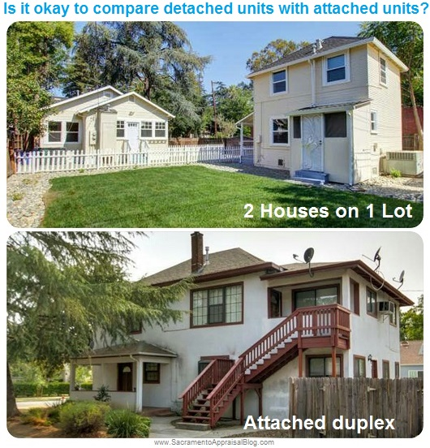
Adjustments
Major Types:
Amount is allocated by the contributory value not individual cost.
Adjustments should be isolated and are always made to comparable properties, never to the subject
Time of sale
Location
Physical condition
Contributory value of components

Slide 86
Cost
Cost doesn’t always equal value, but is a valid determinant of value
Improvement Cost New –
Depreciation
+
Land Value
=
Property Value
Notes:
Takes the components of a house and assigns a price per sq. foot based on style/materials/finish and adds value for amenities, quality, condition, etc.
Based on Principle of Substitution
May be applied to most classes of property
Most counties do a market adjusted cost valuation. Cost models are built and adjusted to the local market.
Advantages:
Sometimes the only approach for special purpose properties
Universal application
Well adapted and easily applied under a mass appraisal system
Disadvantages:
Difficulty in estimating depreciation especially in older structures

Slide 87
WAC 458-14-116
Orders:
State the facts and evidence upon which the decision is based and the reasons for the decision.
Must be issued within 45 days of the hearing.
Both parties may appeal to the BTA within 30 days of the mailing date.
If the property value decreases:
The value becomes effective on the mailing date, even if appealed.
If the property value increases:
The value becomes effective 30 days after the mailing date, unless appealed.
Reconsiderations:
Should only be used to correct an egregious error.
The standard recourse is for the aggrieved party to appeal to the BTA.
Decisions
Notes:
If the Board cannot achieve a quorum, such as a tie vote, the Board sustains the assessor’s determination.
This may not sit well with the taxpayer so you can:
remind them of their right to appeal the decision to the BTA.
Orders:
Mailed to the appellant and the assessor, and a copy is retained for the record.
Appeal rights must be stated on the order, usually on the bottom. WAC 458-14-116(3)(b).
Fun Fact: BOE is the only one that can increase the value
Reconsiderations:
The Department has advised boards that they may choose to accept and review requests for reconsideration

Slide 88
Forms & Publications:
Public Access Forms:
Forms (Public Access)
Public Access Publications:
Publications (Public Access)
Member Resources:
Property Tax Resource Center (PTRC)
Appeals
Current Use
Senior Exemption & Deferral Forms
Forest Land
Refunds and Waivers
Appealing to the BOE
Designated Forestland
Guide to Mass Appraisal
Guide to Property Tax
1% Property Tax Limit
Paying Taxes Under Protest
Special Notices
State School Levy
Finding Training
County Reports & Audits

Slide 89
Wall of Fame:
Board Website Examples:
Online Filing Examples:
Member Resources:
Kitsap
Lincoln
Spokane
King County eAppeals
Cowlitz Appeal & Dashboard
Lewis County Online Filing
Snohomish Practice & Procedure Document
Snohomish Appellant Checklist & Tips
Whitman Letter to Taxpayers

Slide 90
Wrap-up & Evaluations
Thank you for your participation today. Let us know how we did by completing this survey by June 11.
Please let me know if you have suggestions OR complaints.
If you indicated you wanted a certificate of attendance during registration, we will send yours within a few days. Or you may email dorpropertytaxeducation@dor.wa.gov to make a request.
Training Season:
Basic BOE: Online in future since, only 1 registrant for the in-person class
Senior BOE: Online, topics and questions were due with registrations. Did not get much.
June 5: Full
June 24: Full
June 26: Open
Board of Equalization Training – New Members & Clerks

Slide 91
Contact Us
Website
https://propertytax.dor.wa.gov/
Phone Number
360-534-1400
For any questions or to get help from our experts
Email
rikkib@dor.wa.gov
dianabu@dor.wa.gov

